Slide 1
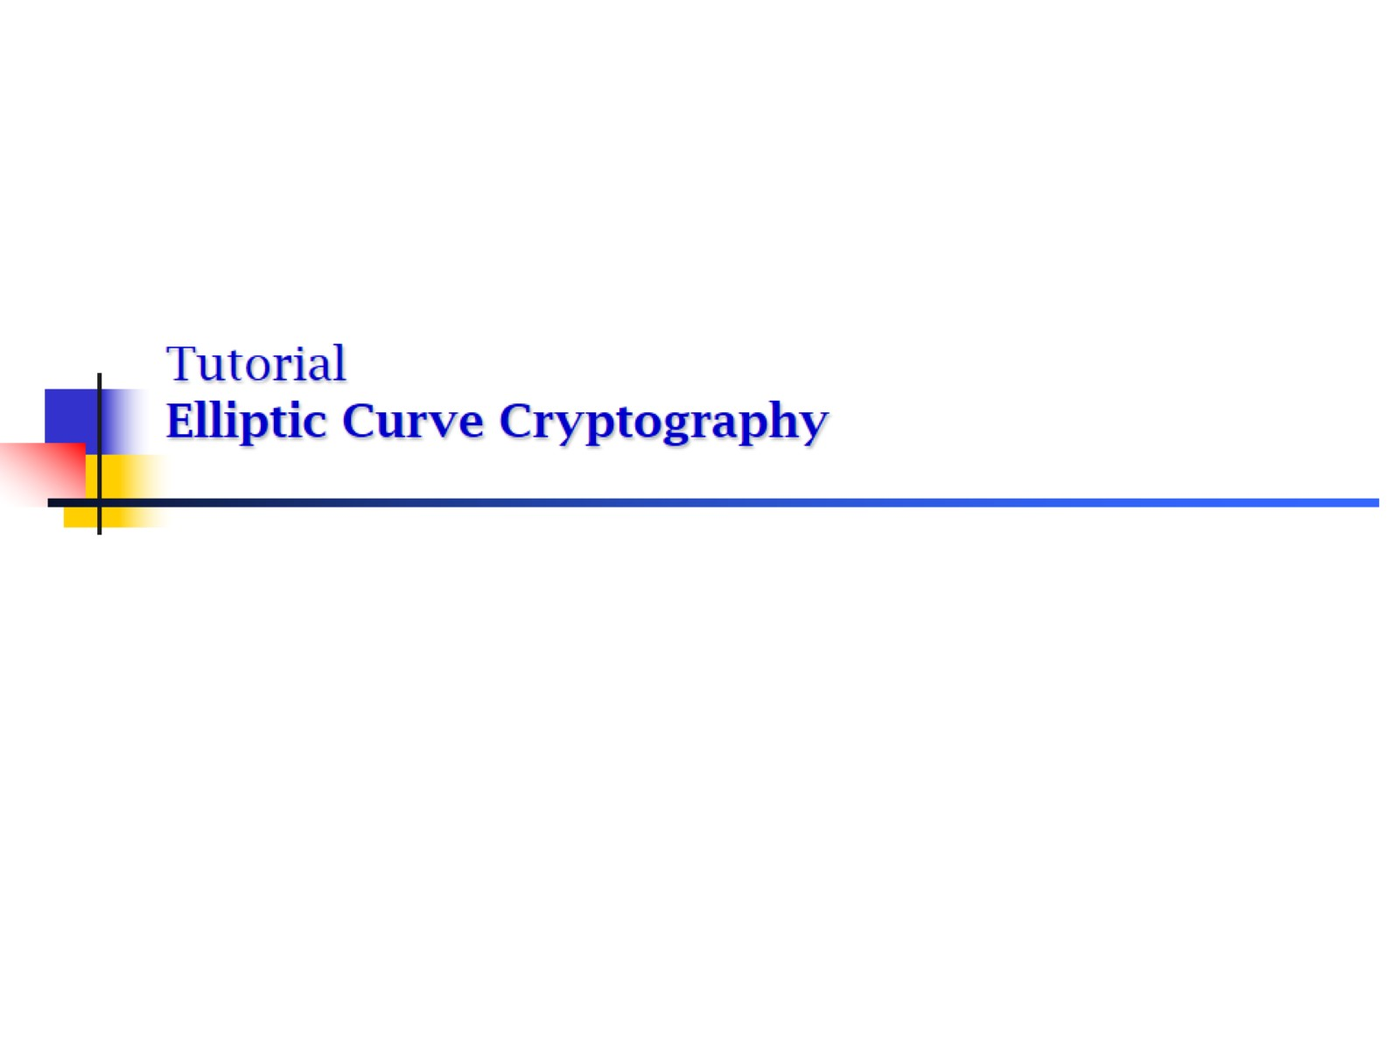
Tutorial Elliptic Curve Cryptography

Slide 2
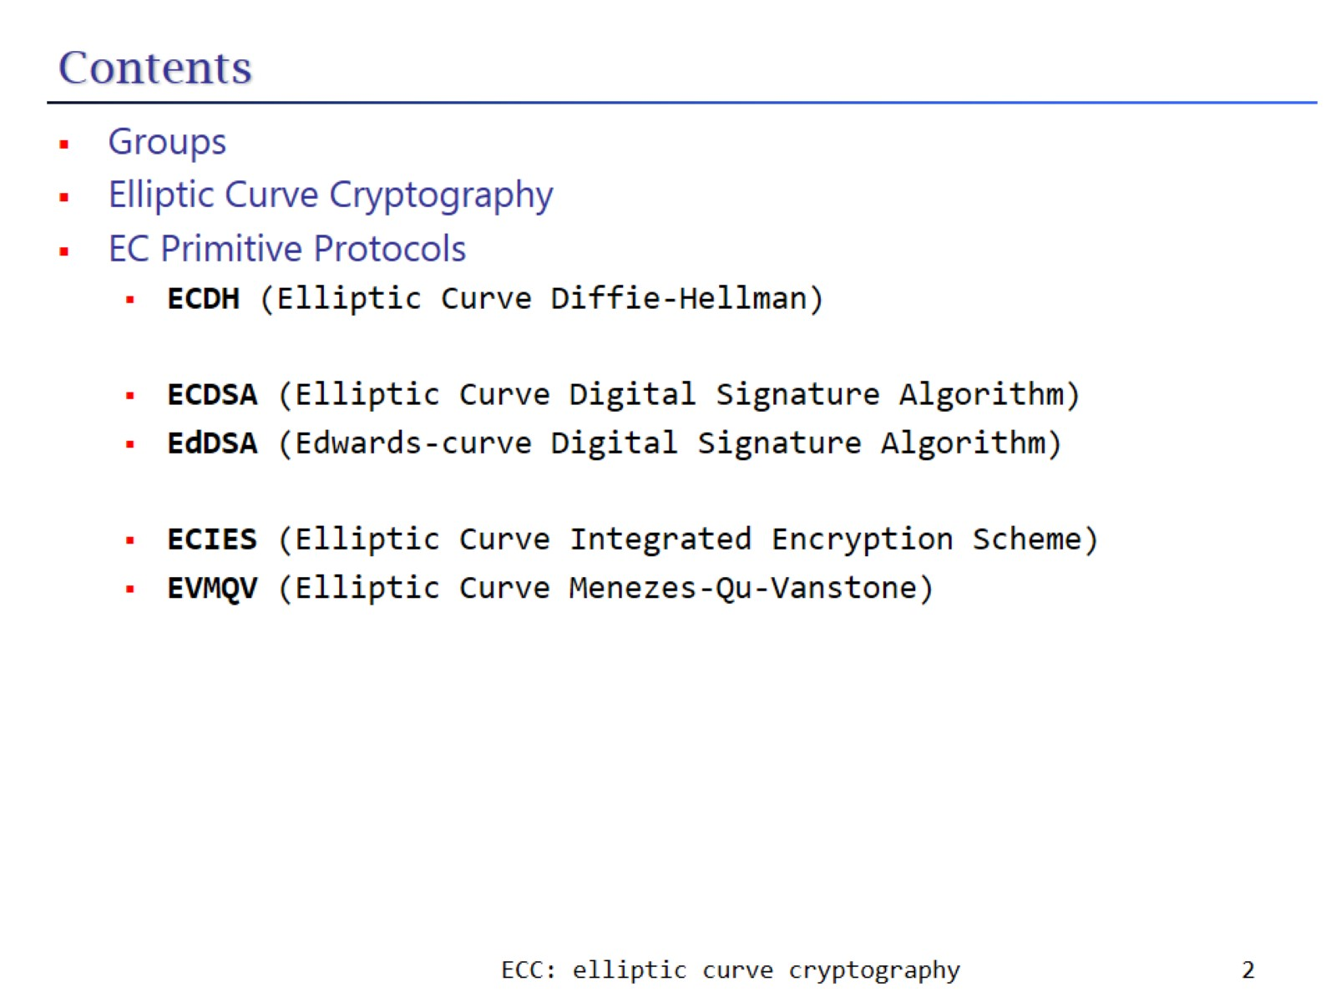
Contents

Slide 3
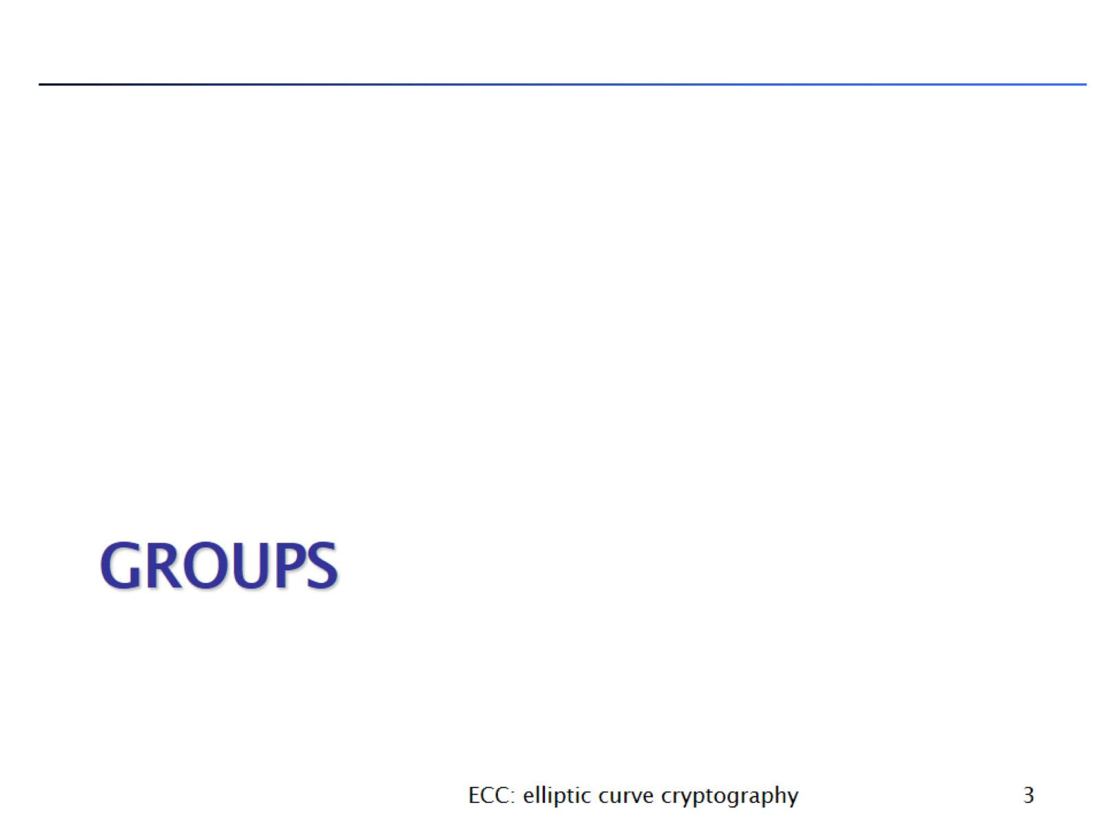
GROUPS

Slide 4
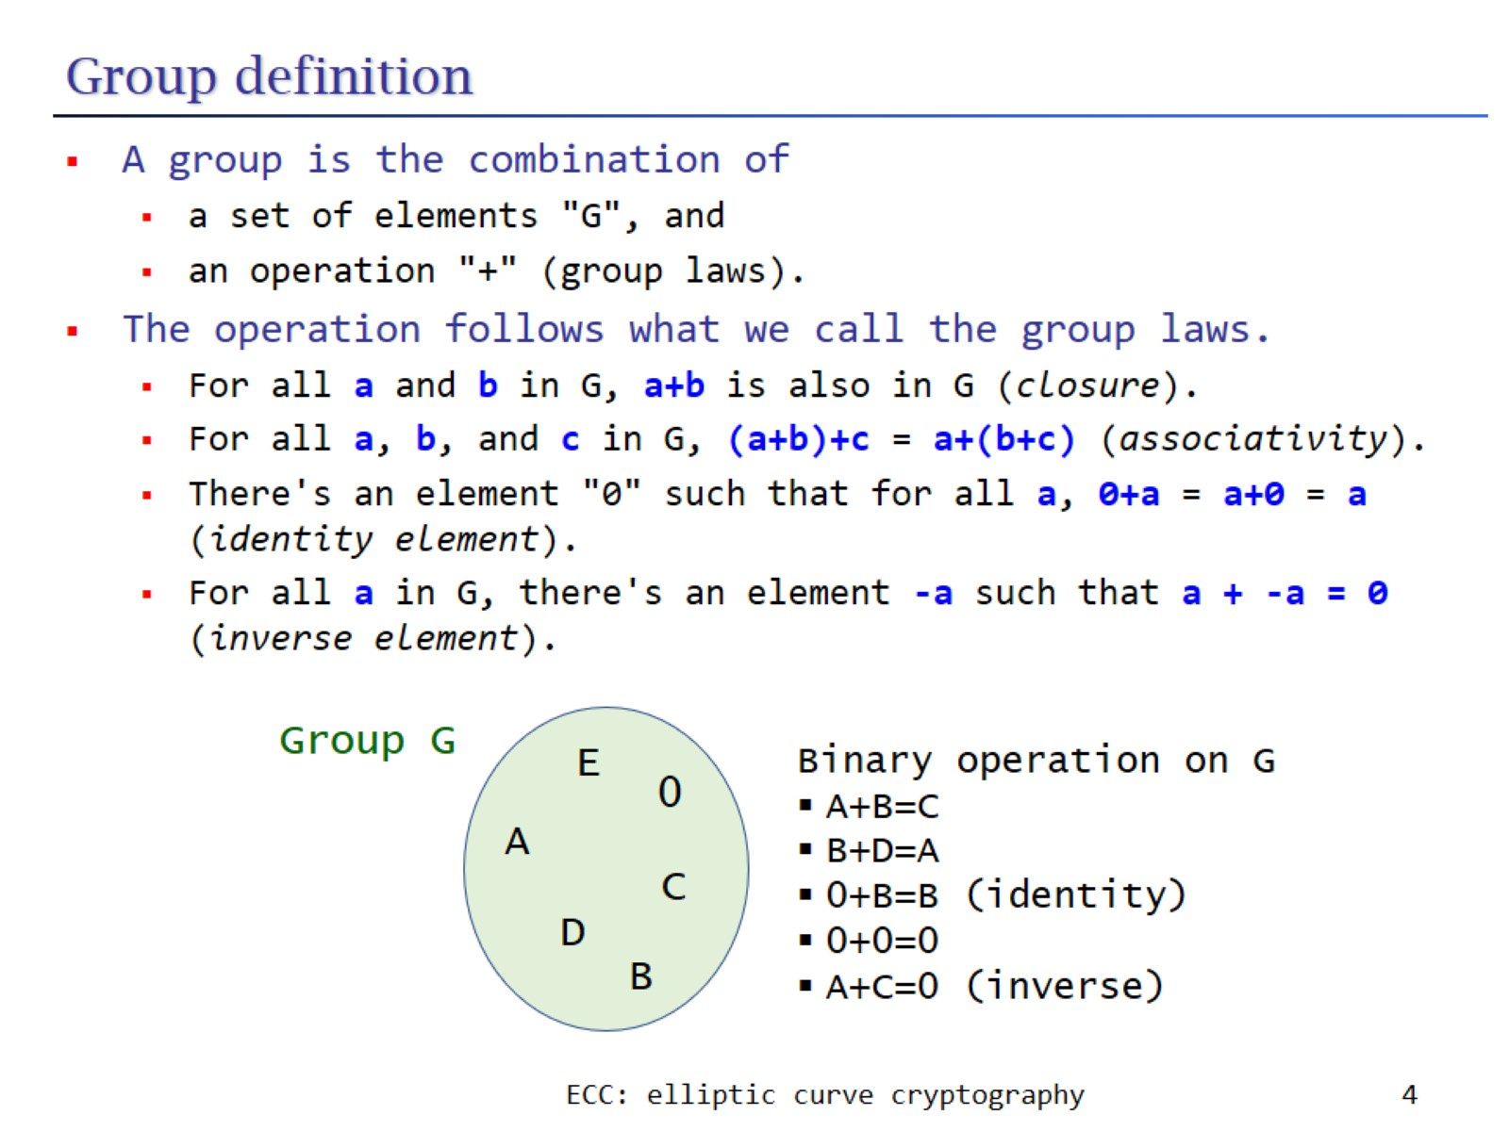
Group definition

Slide 5
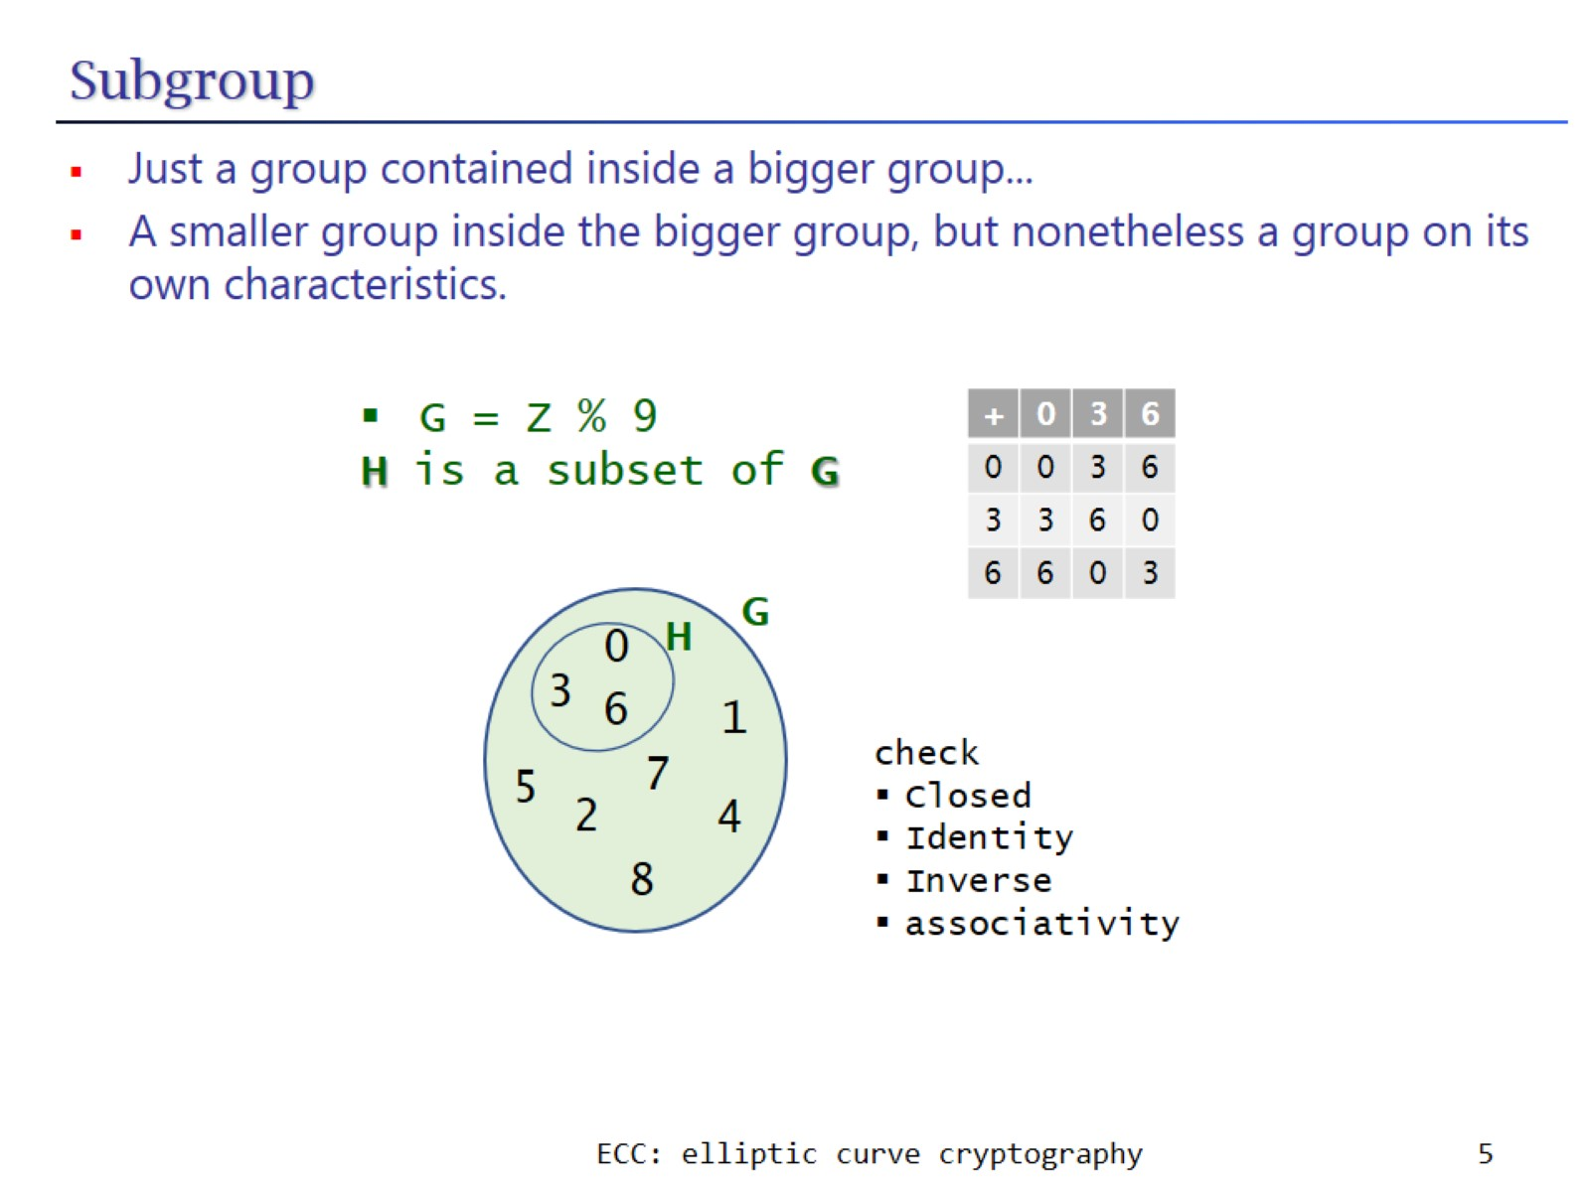
Subgroup

Slide 6
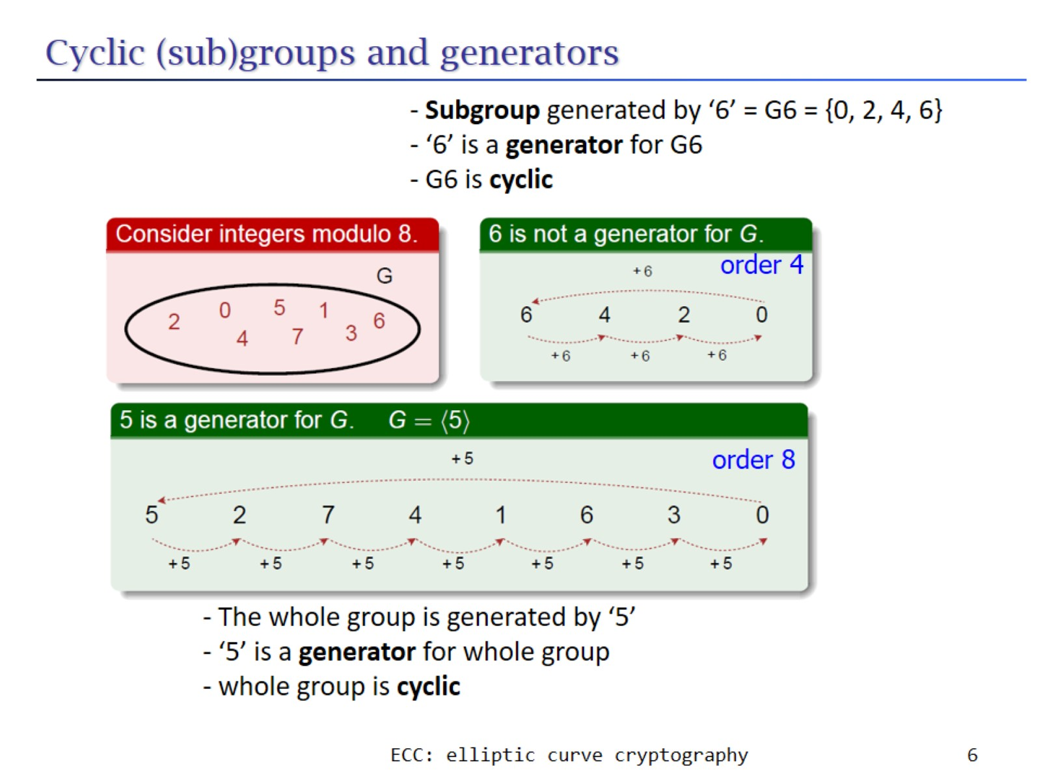
Cyclic (sub)groups and generators

Slide 7
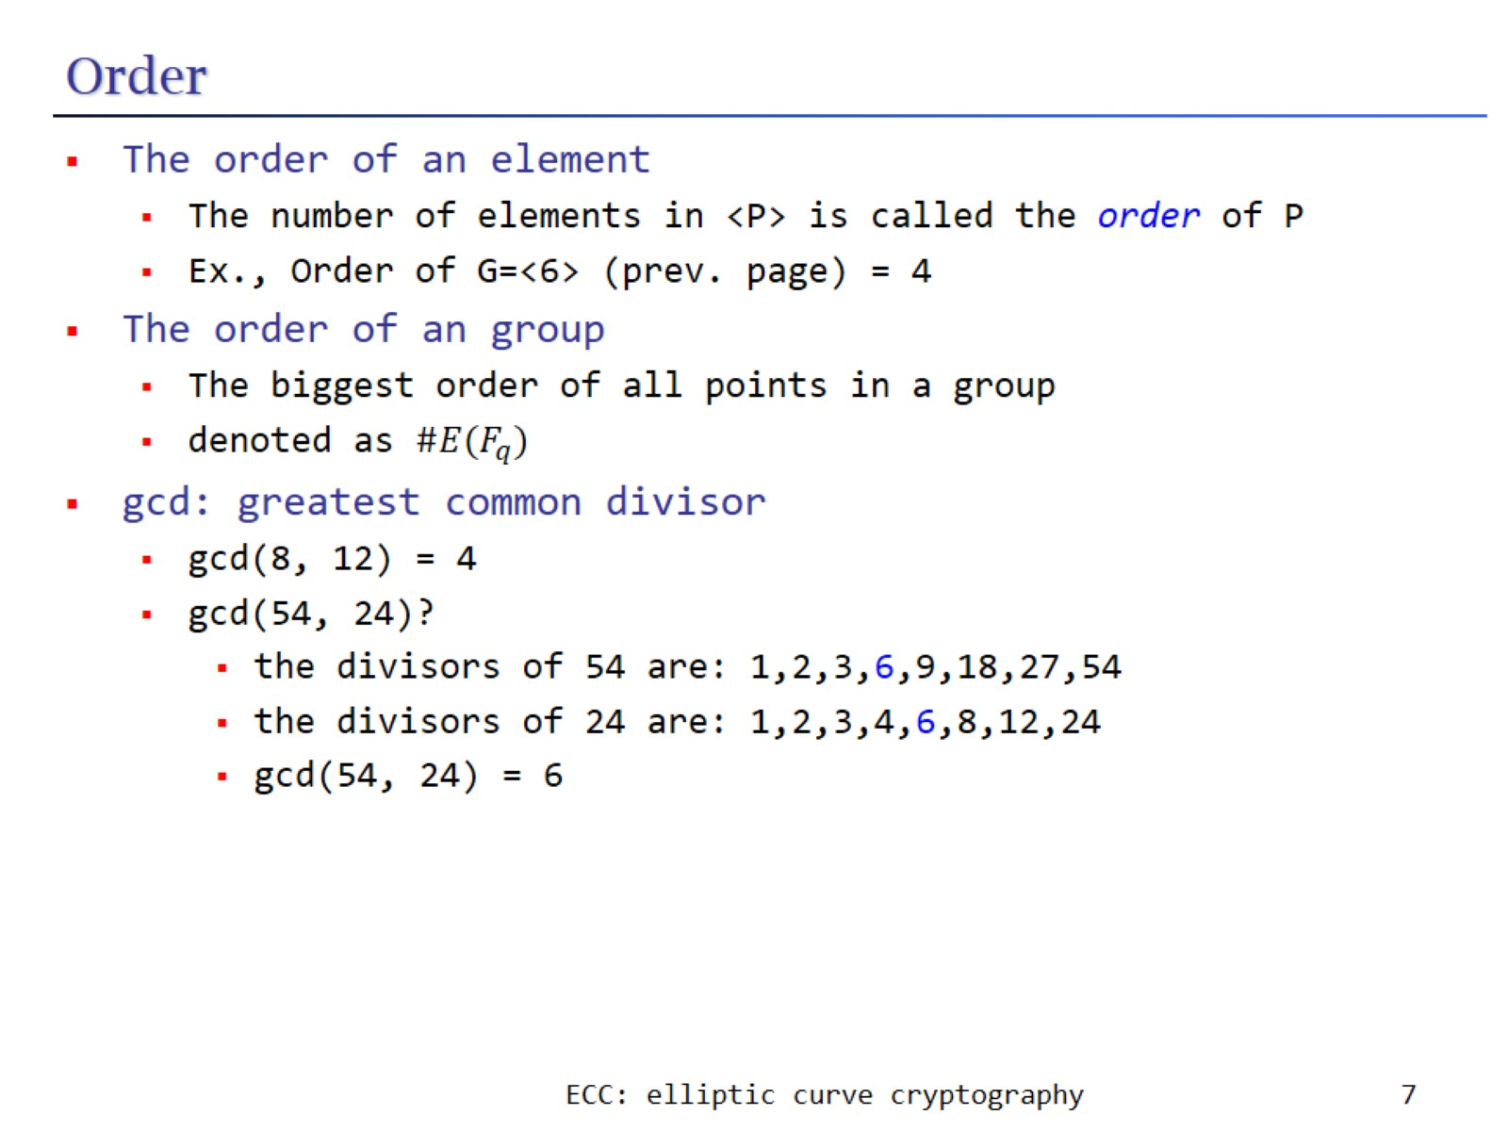
Order

Slide 8
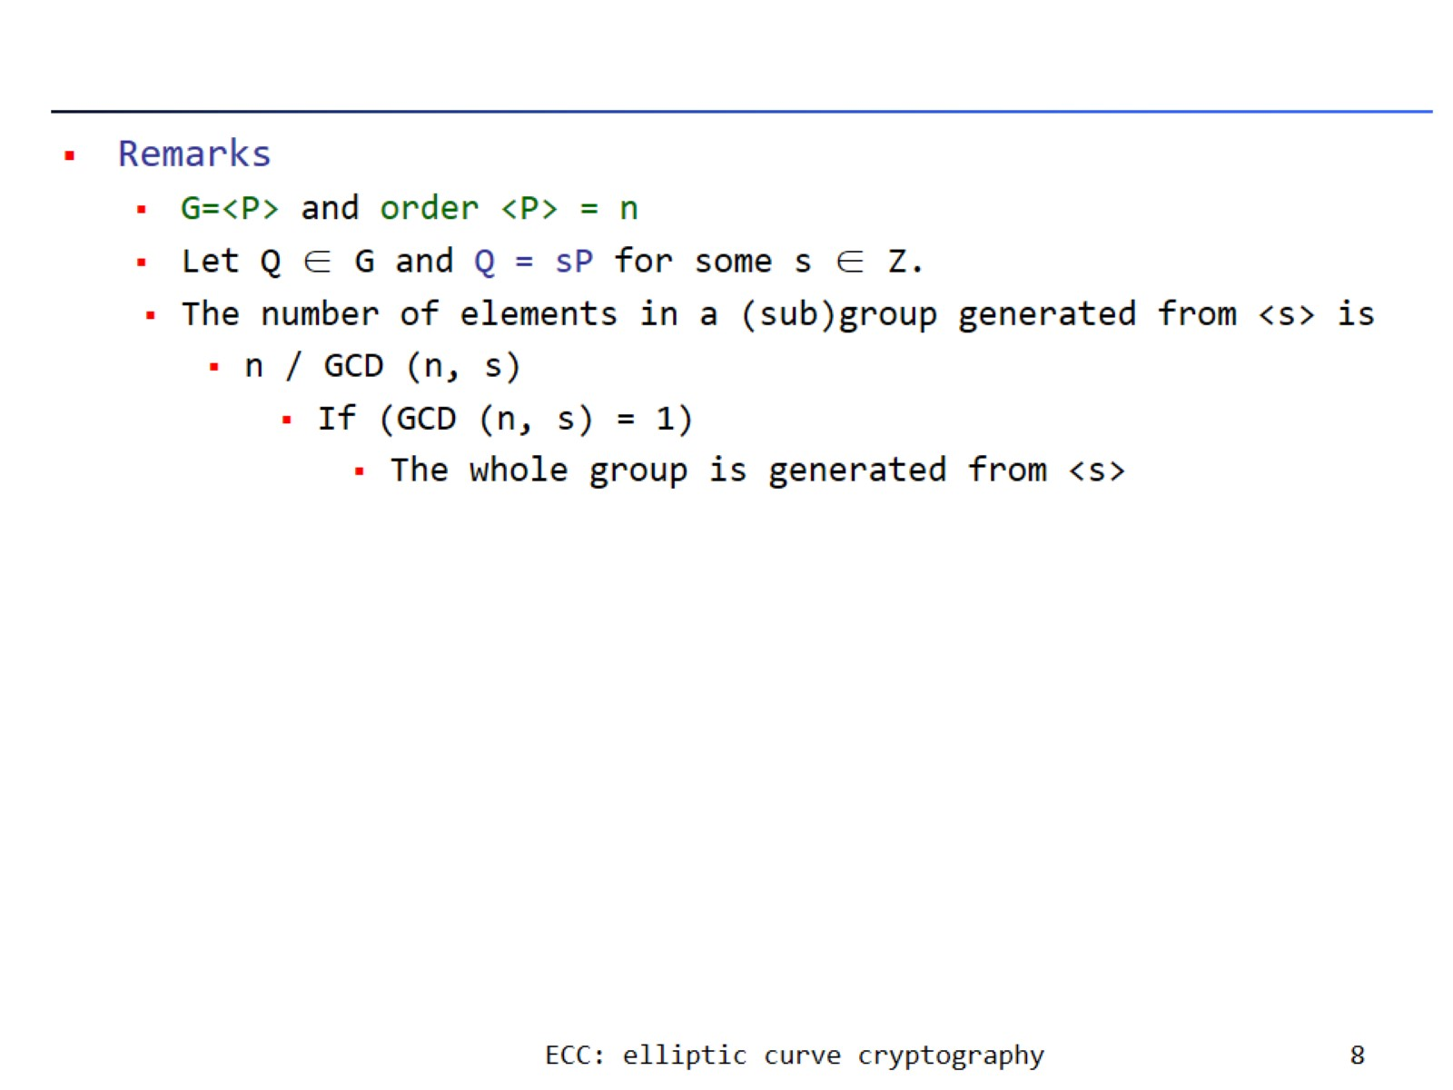

Slide 9
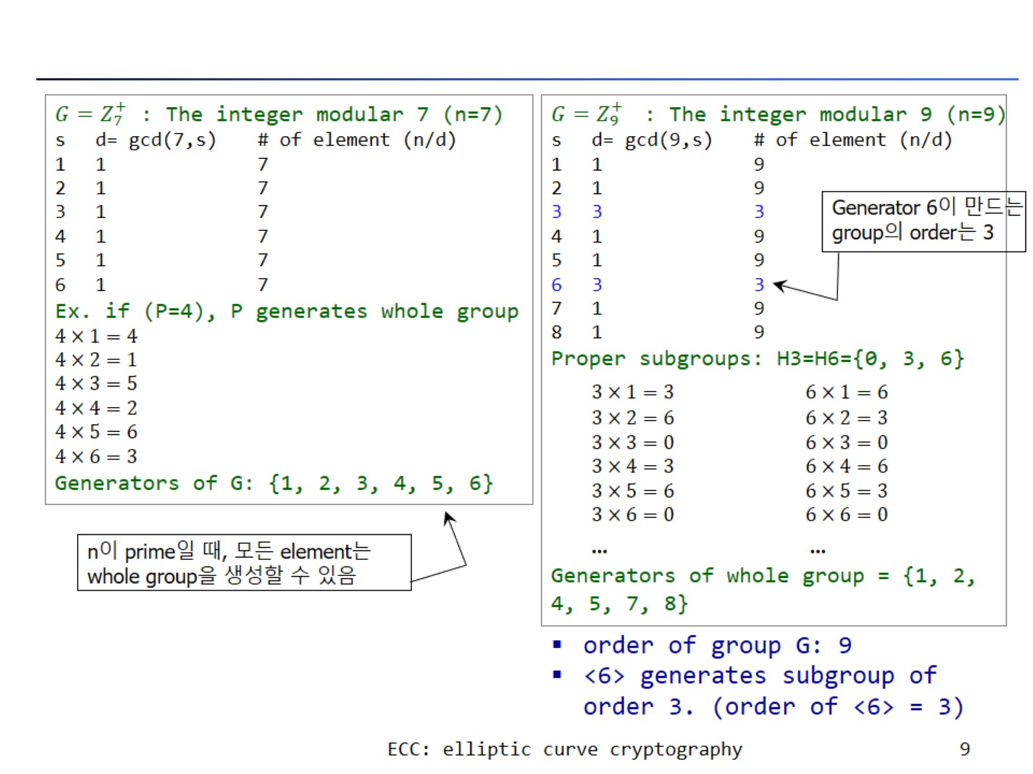

Slide 10
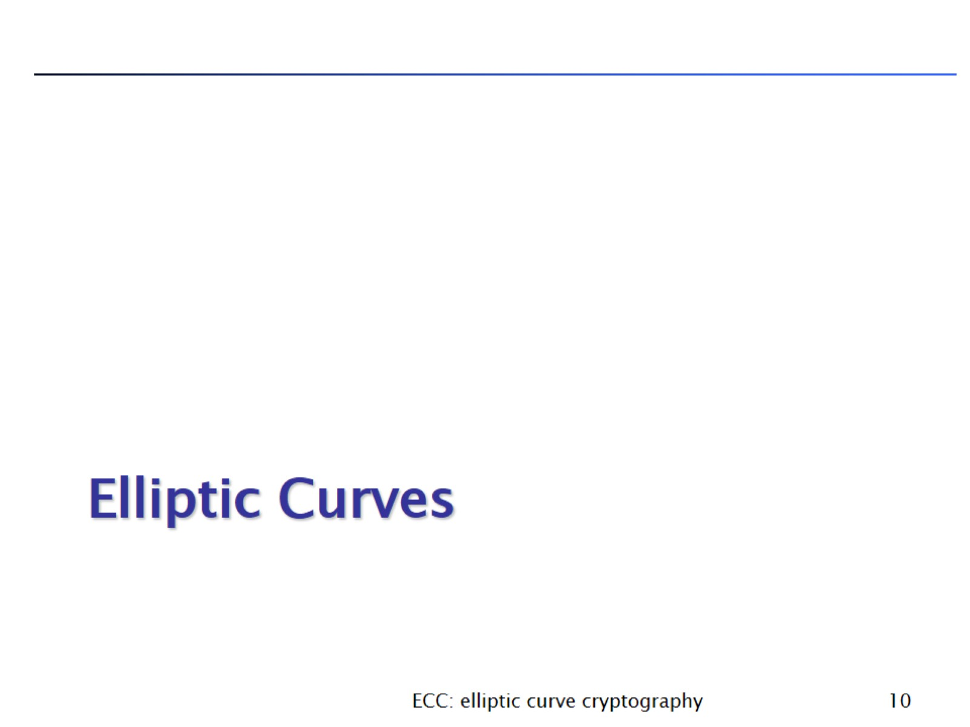
Elliptic Curves

Slide 11
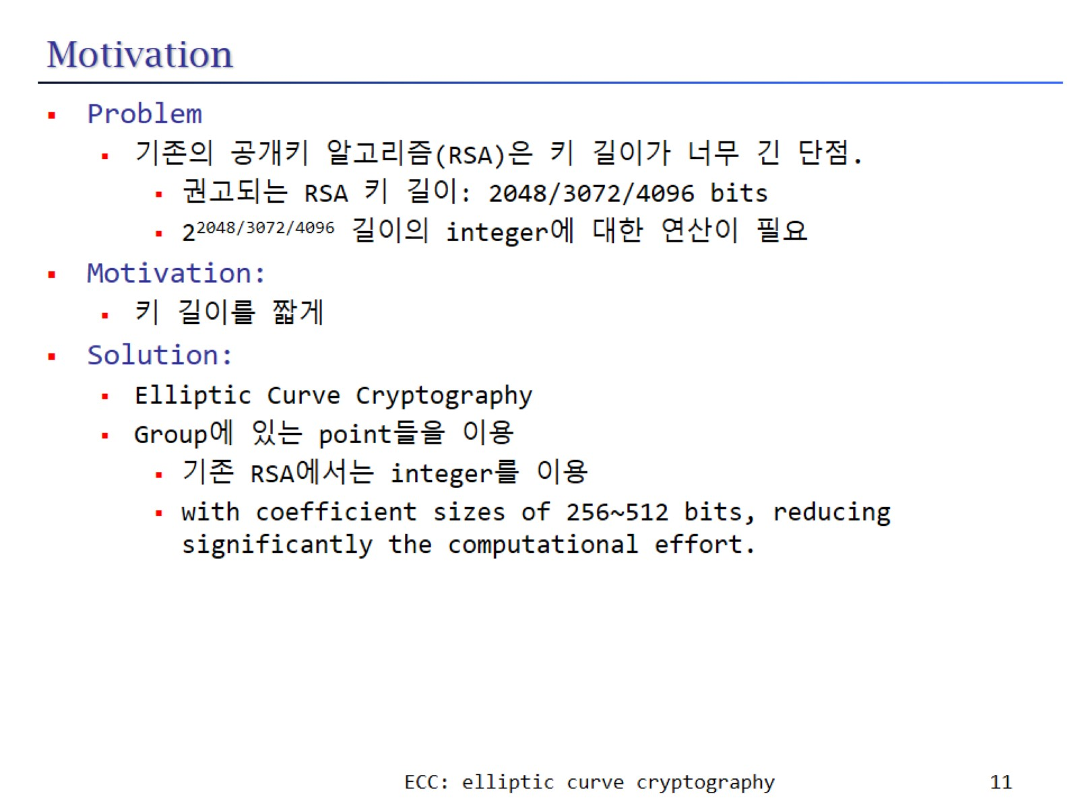
Motivation

Slide 12
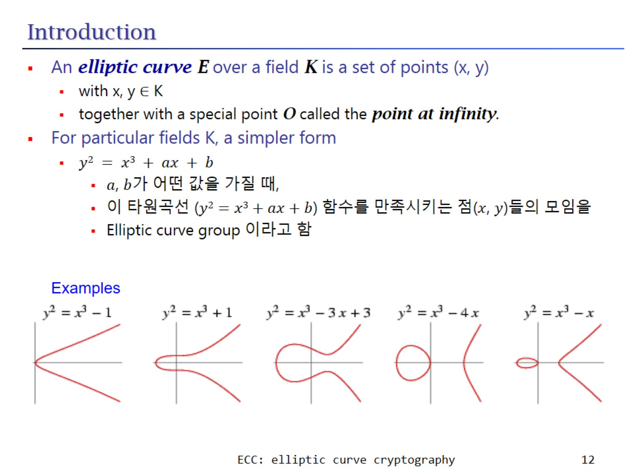
Introduction

Slide 13
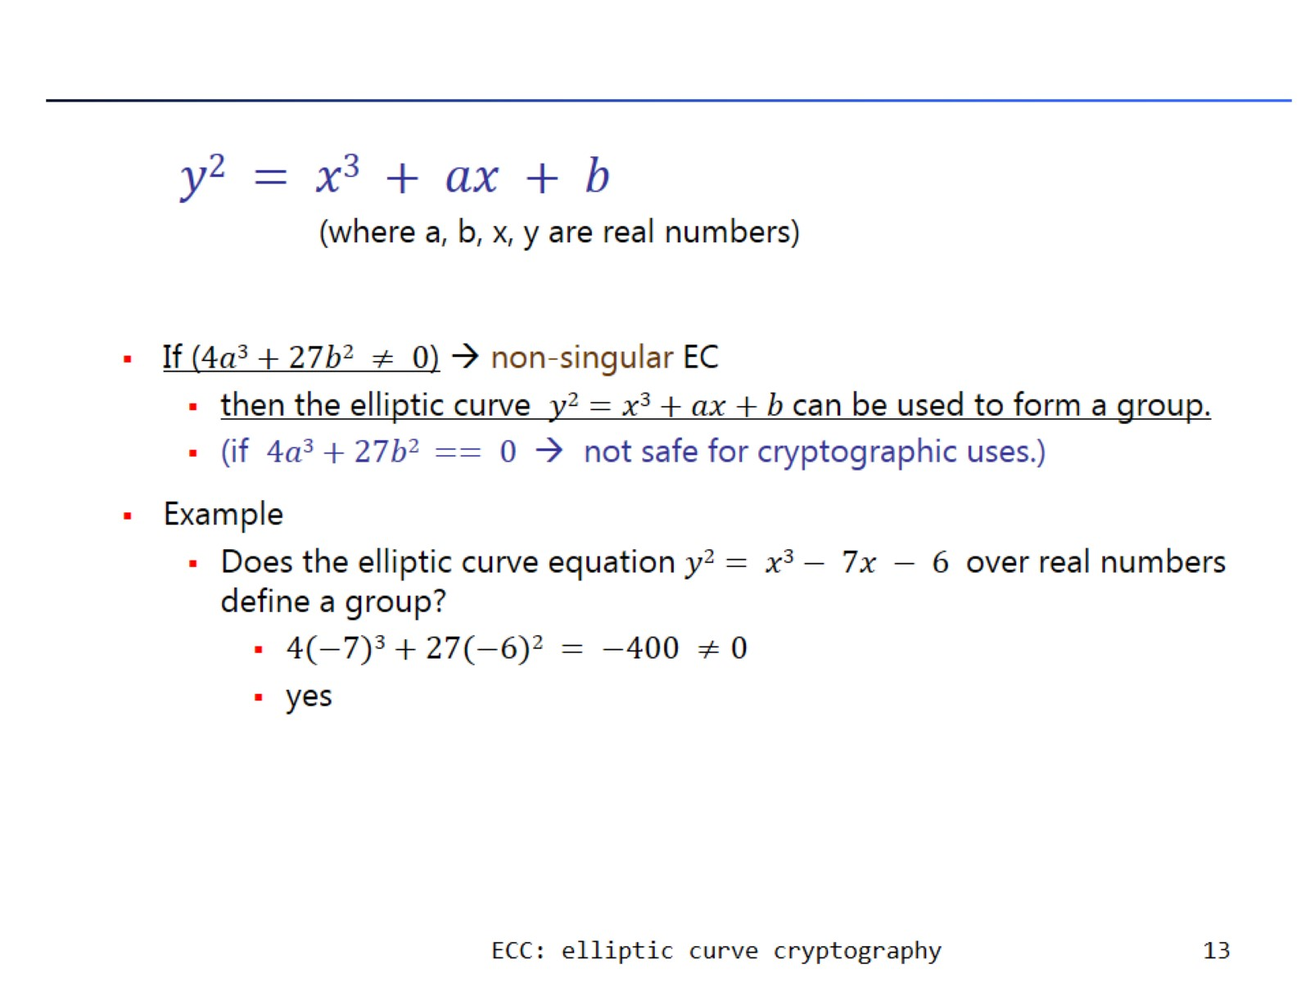

Slide 14
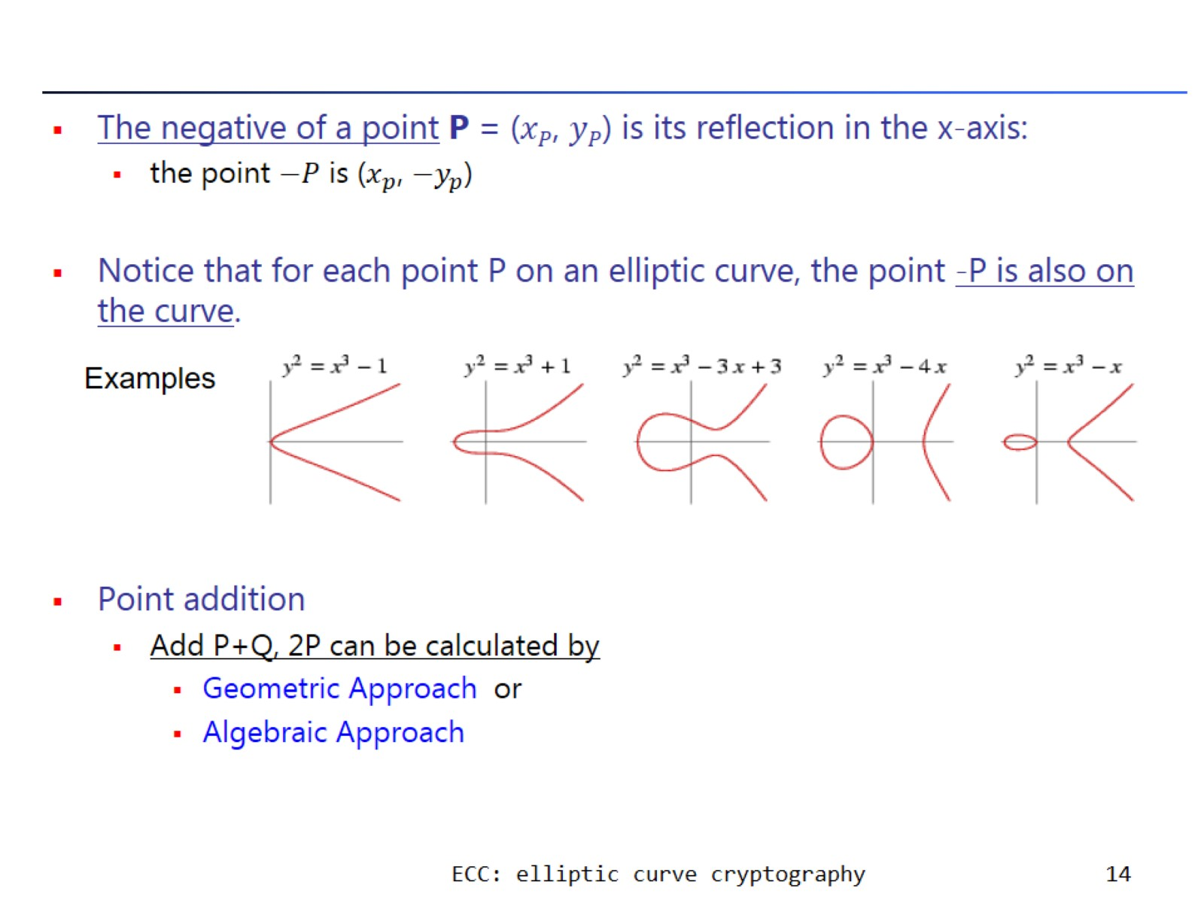

Slide 15
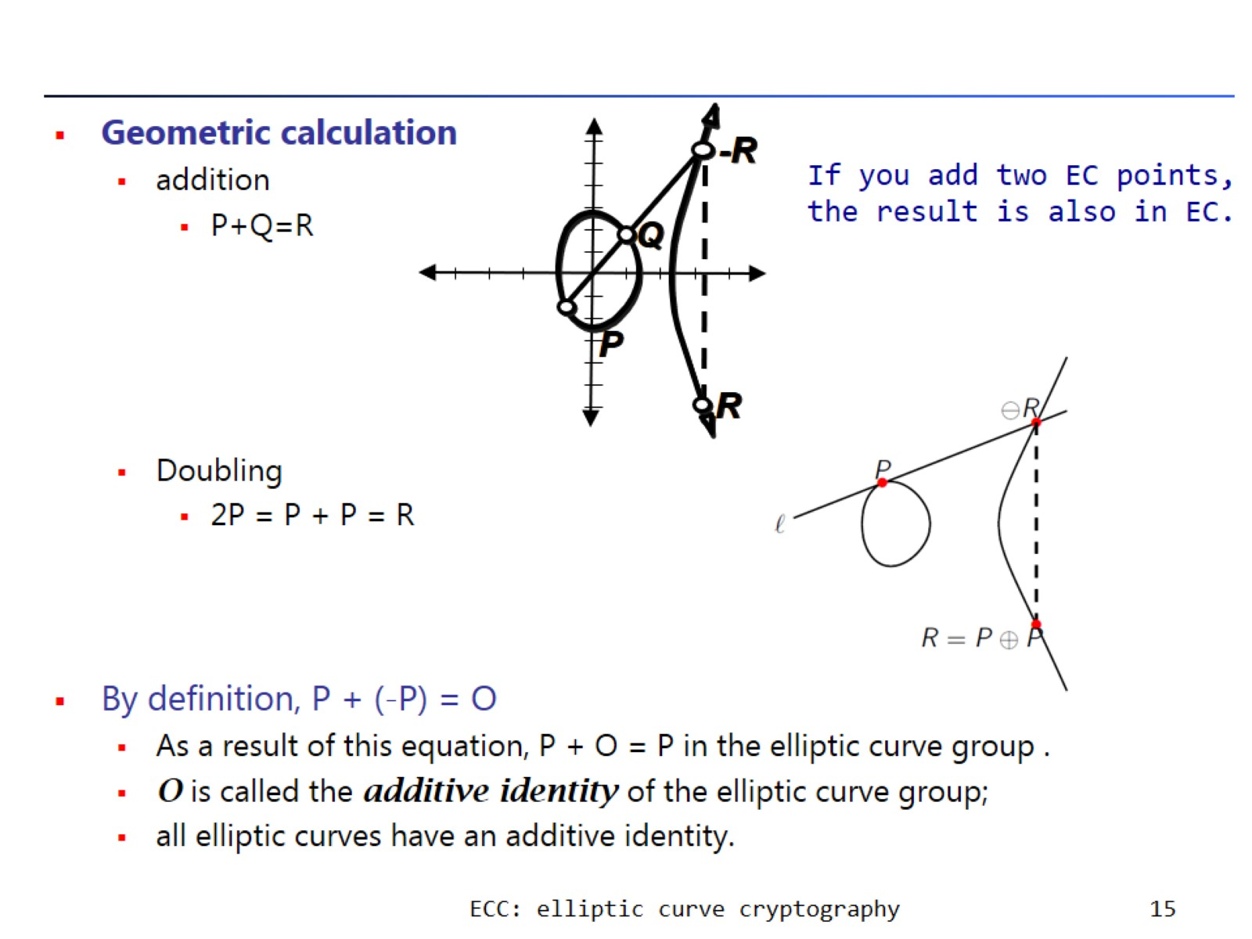

Slide 16
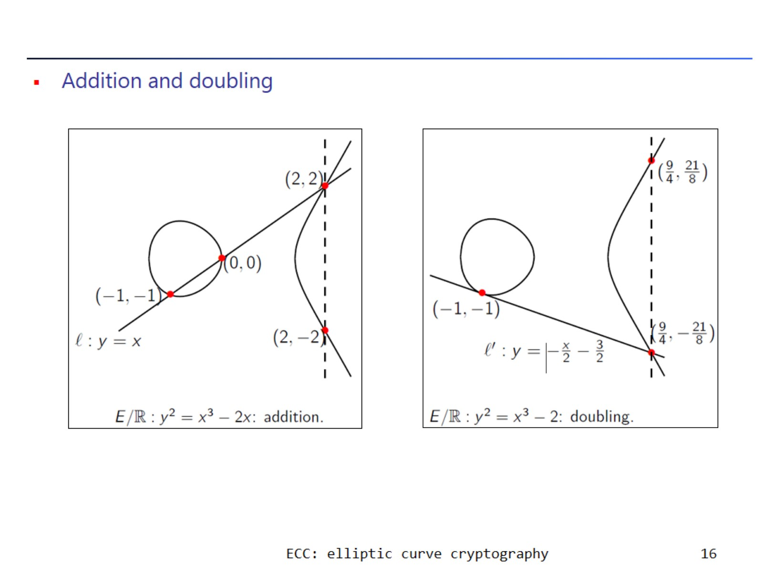

Slide 17
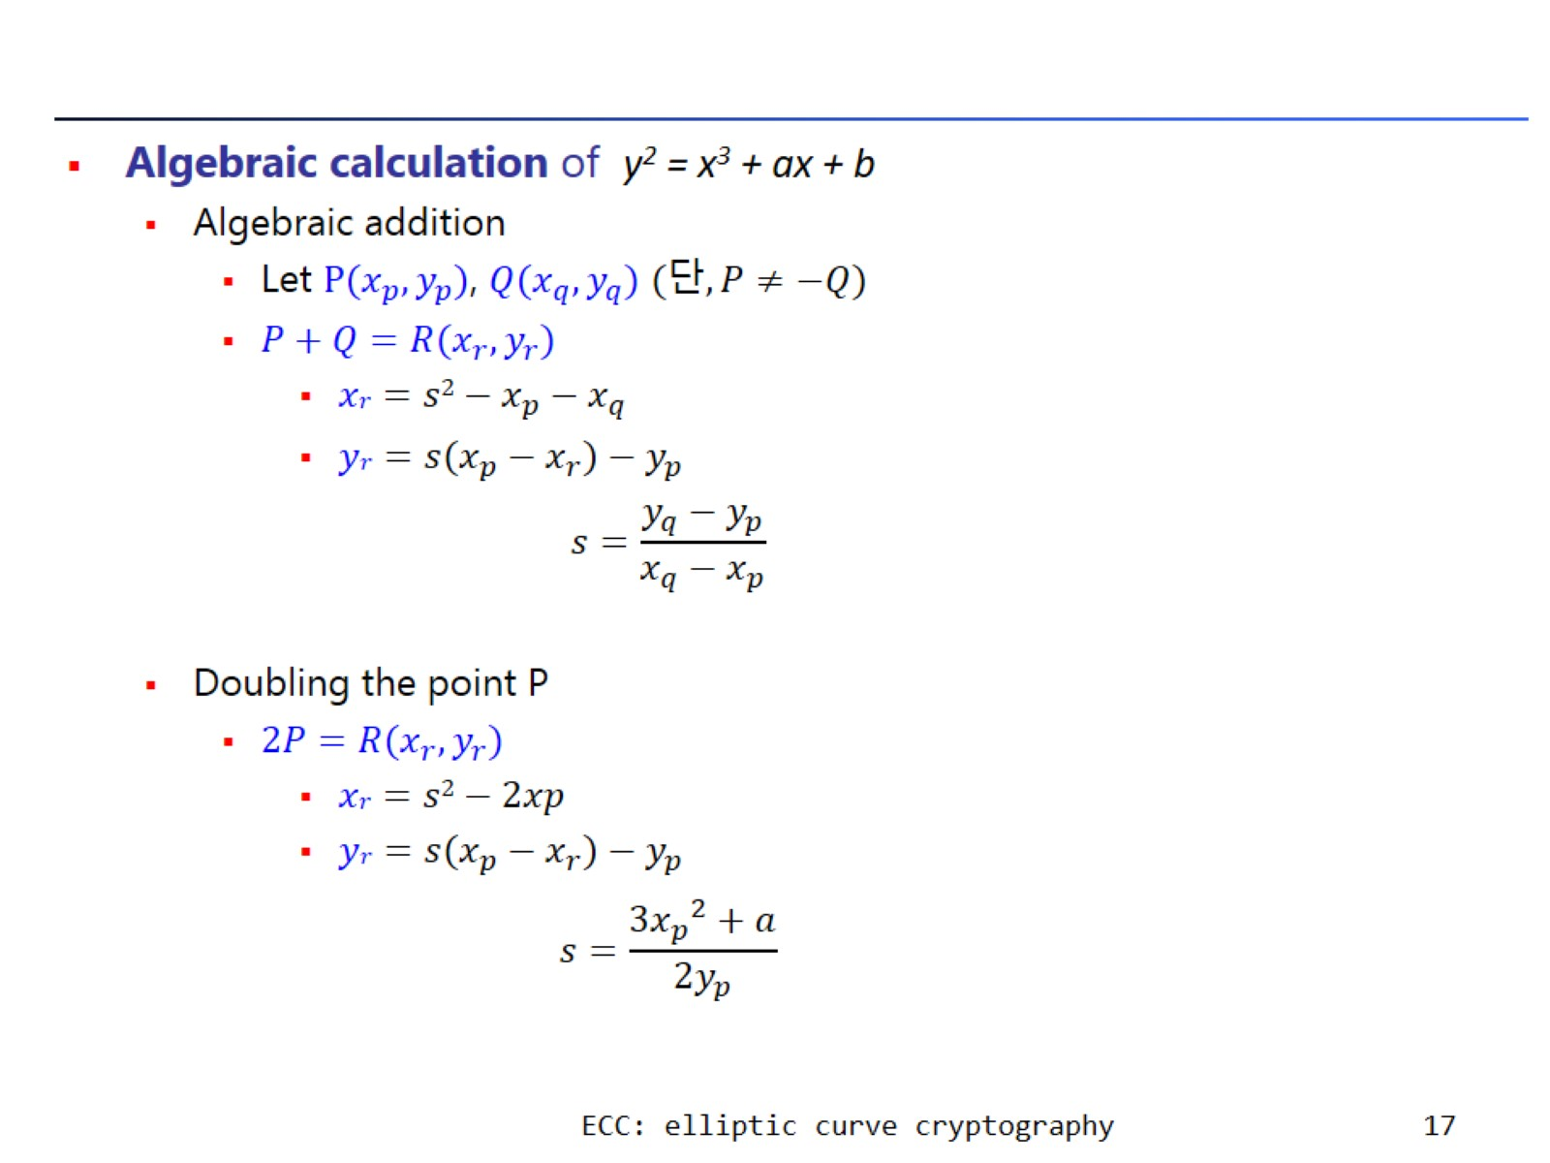

Slide 18
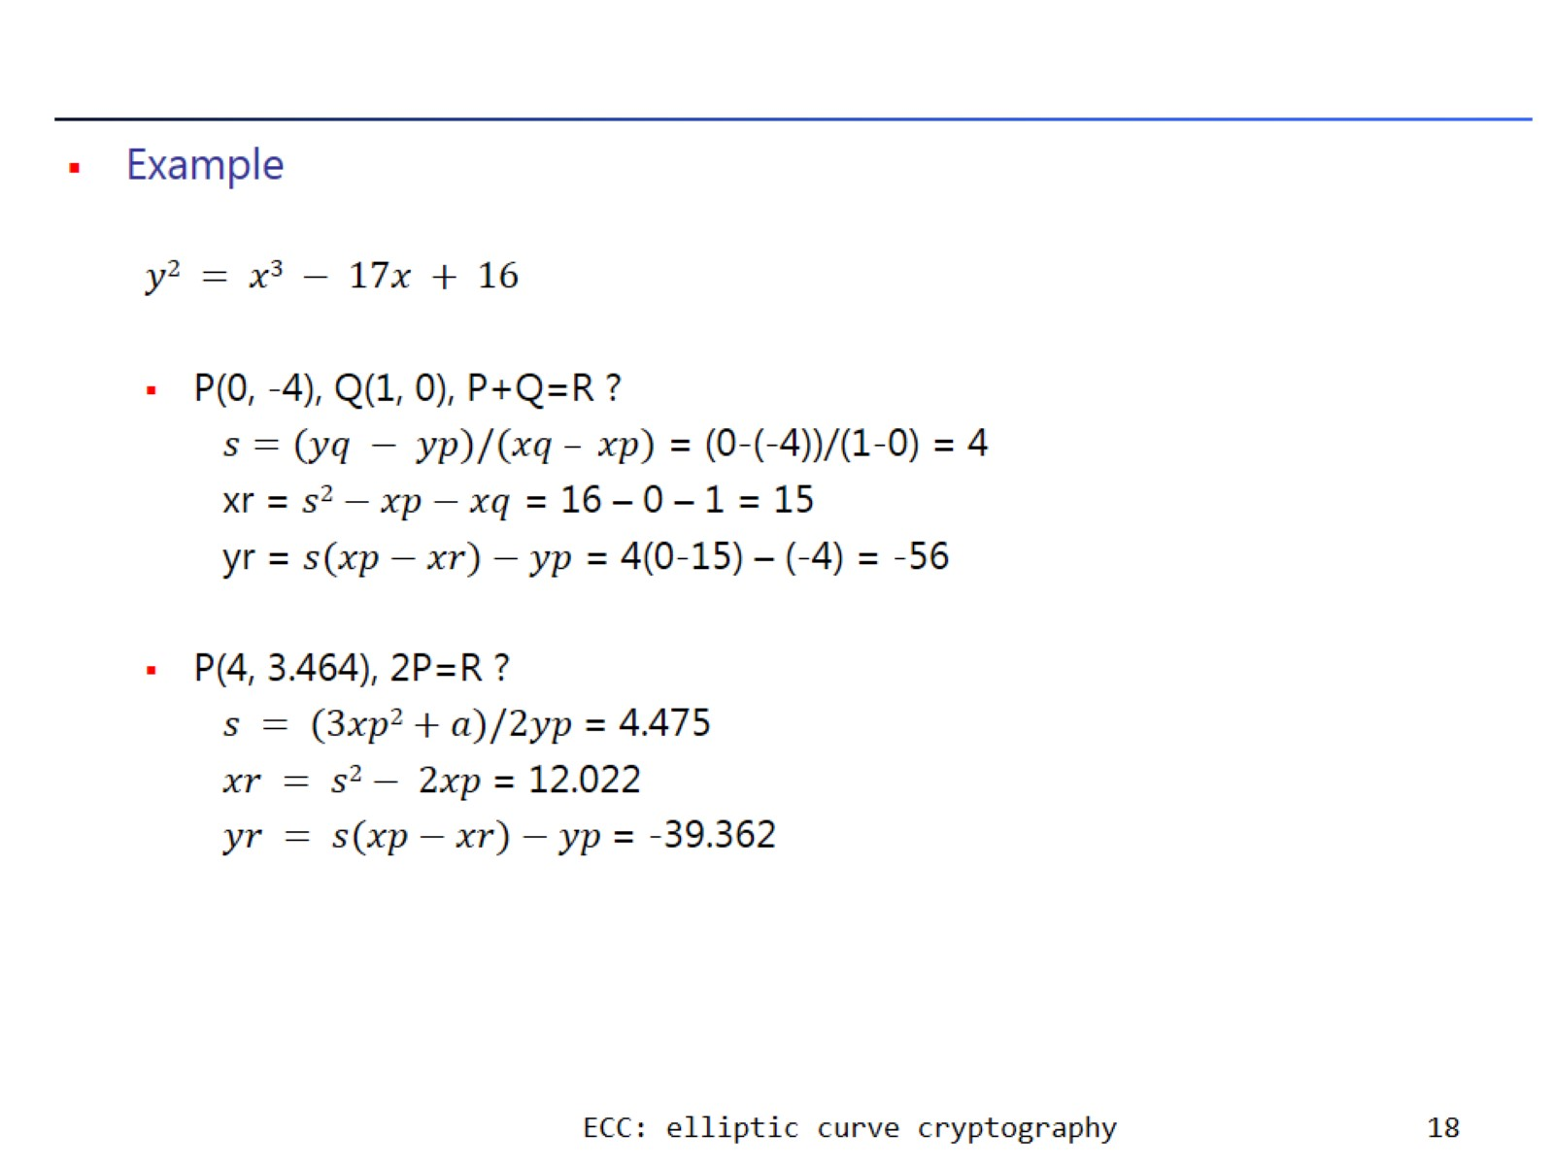

Slide 19
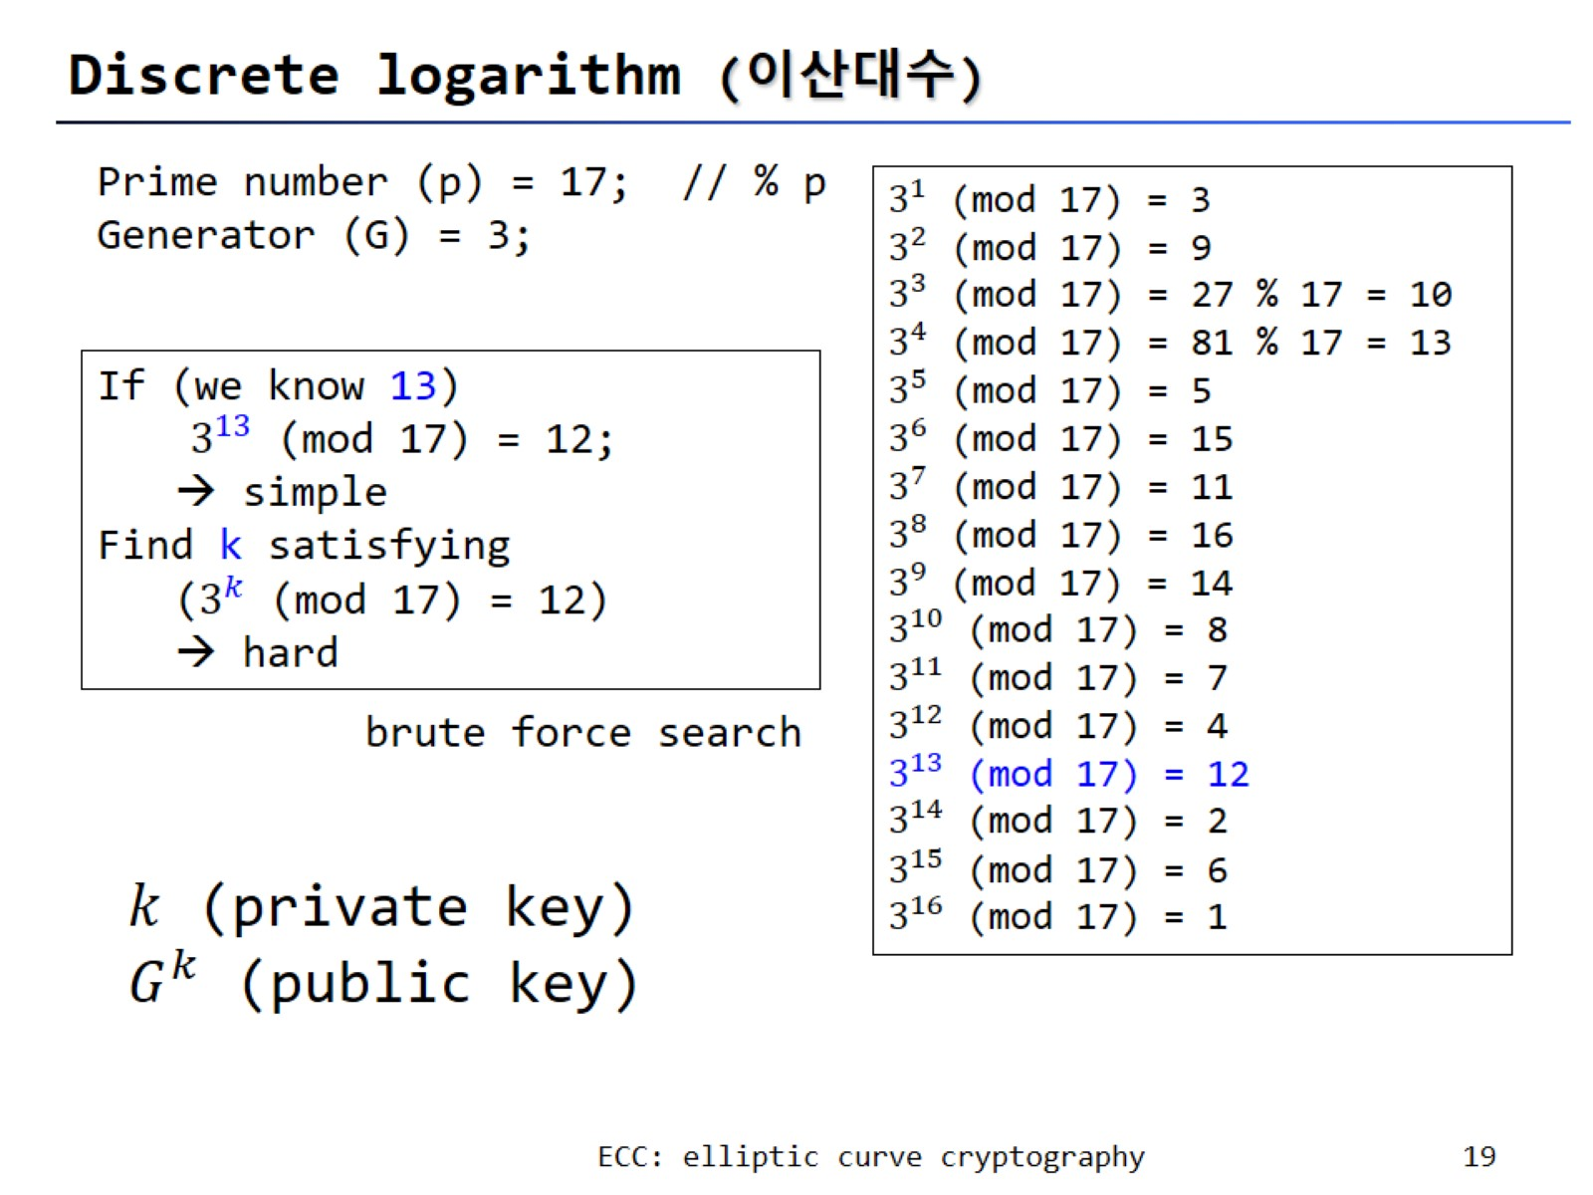
Discrete logarithm (이산대수)

Slide 20
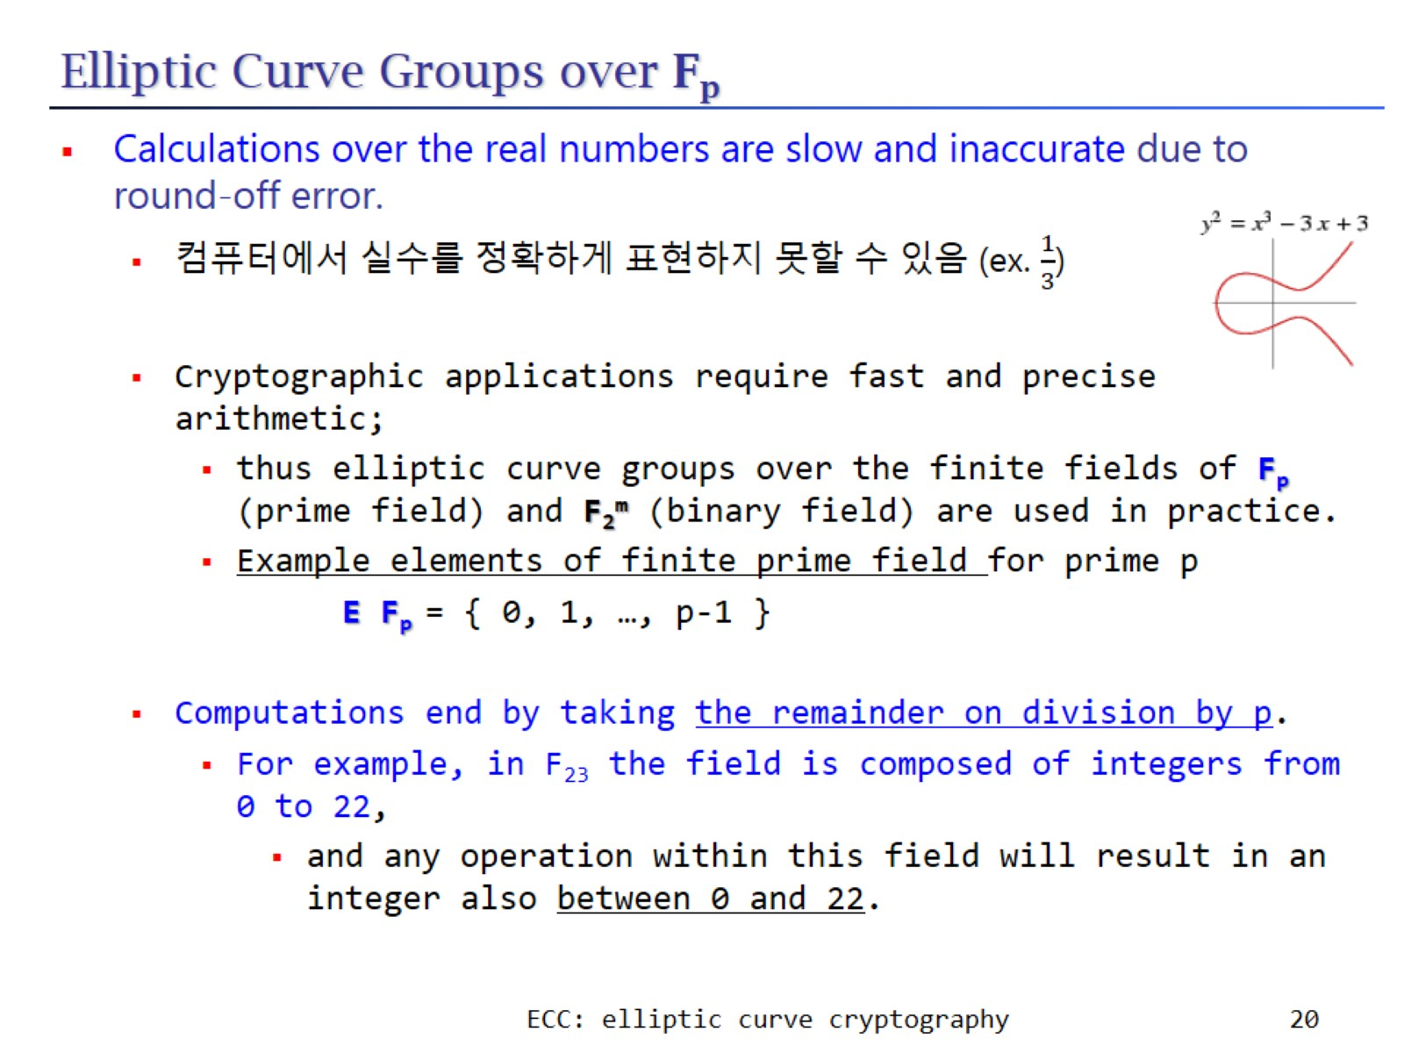
Elliptic Curve Groups over F_{p}

Slide 21
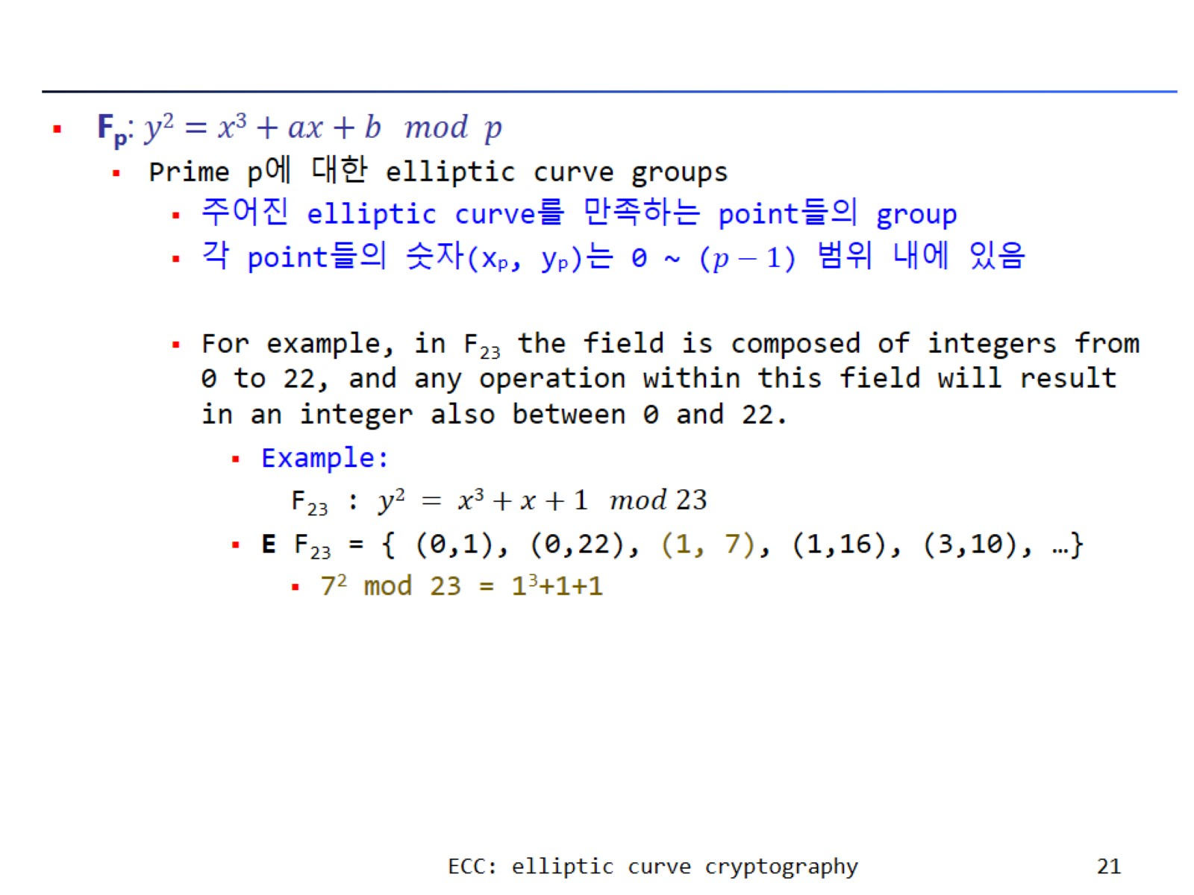

Slide 22
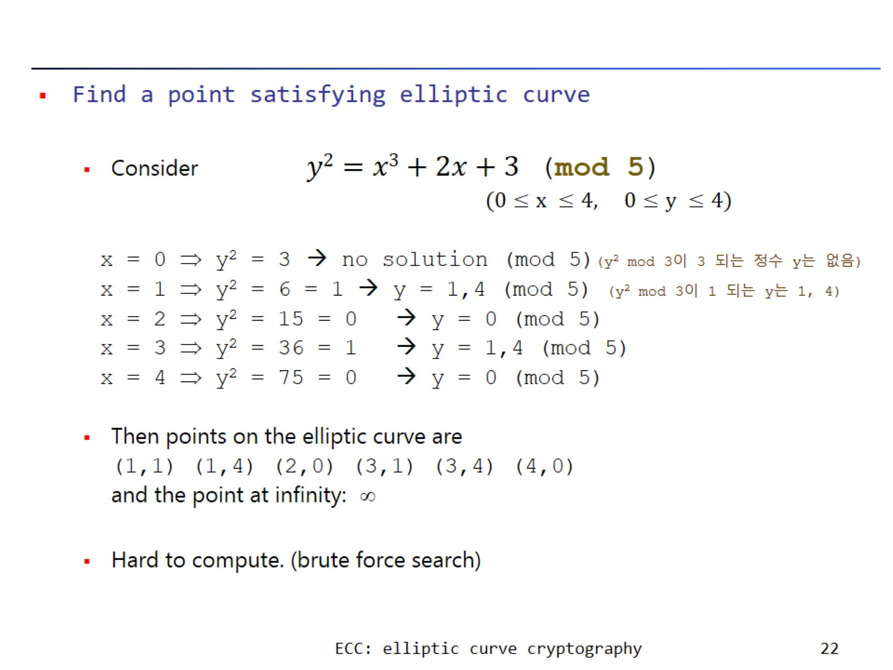

Slide 23
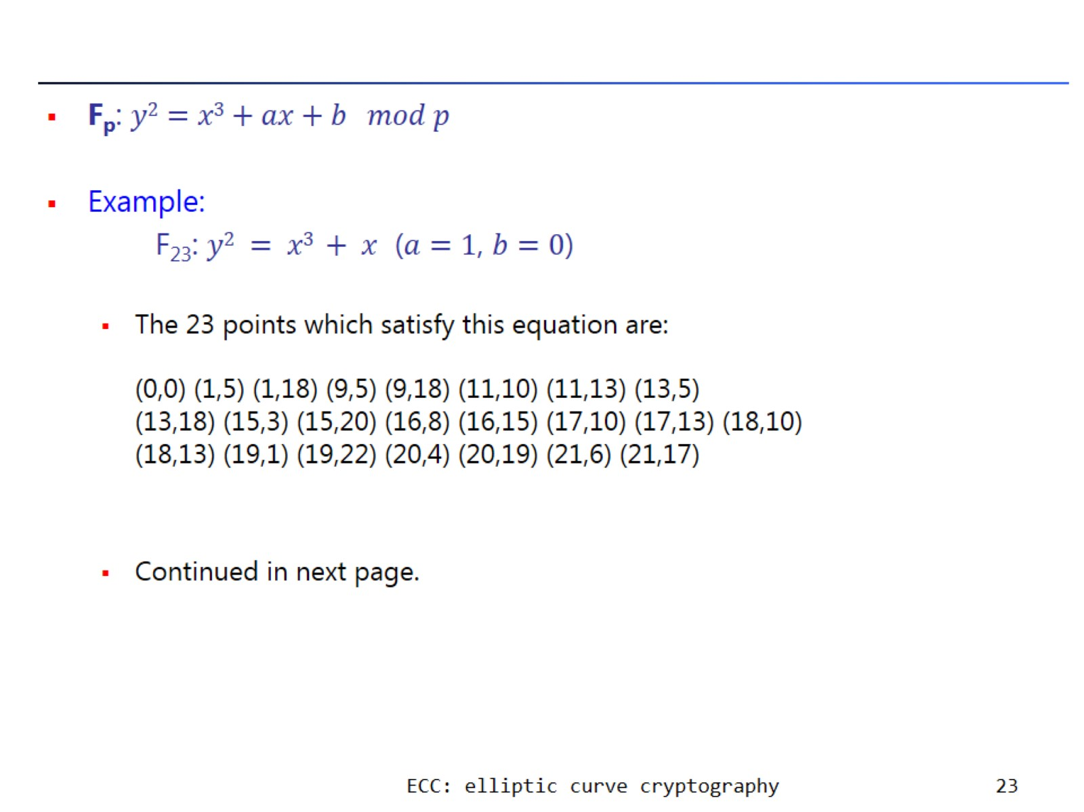

Slide 24
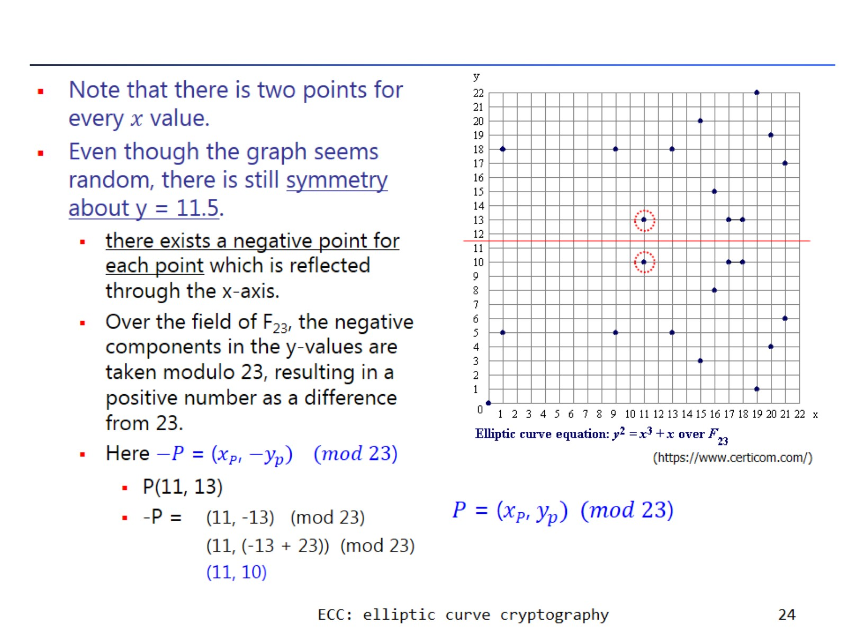

Slide 25
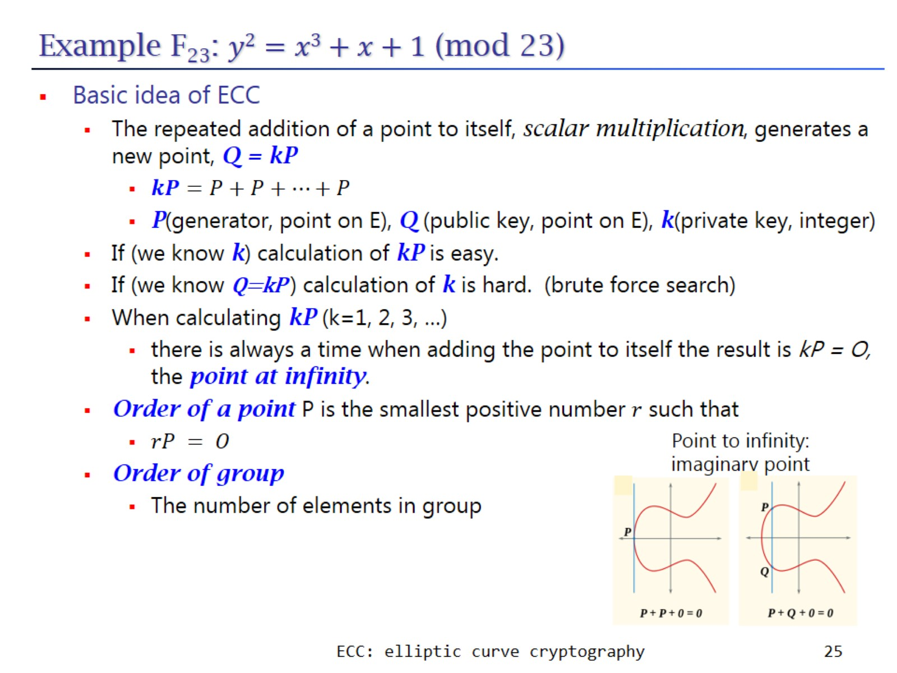
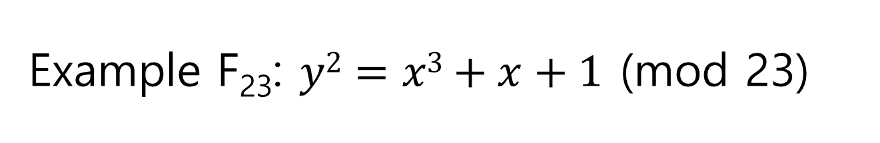
Example F₂₃: $y2=x3+x+1$ (mod 23)

Slide 26
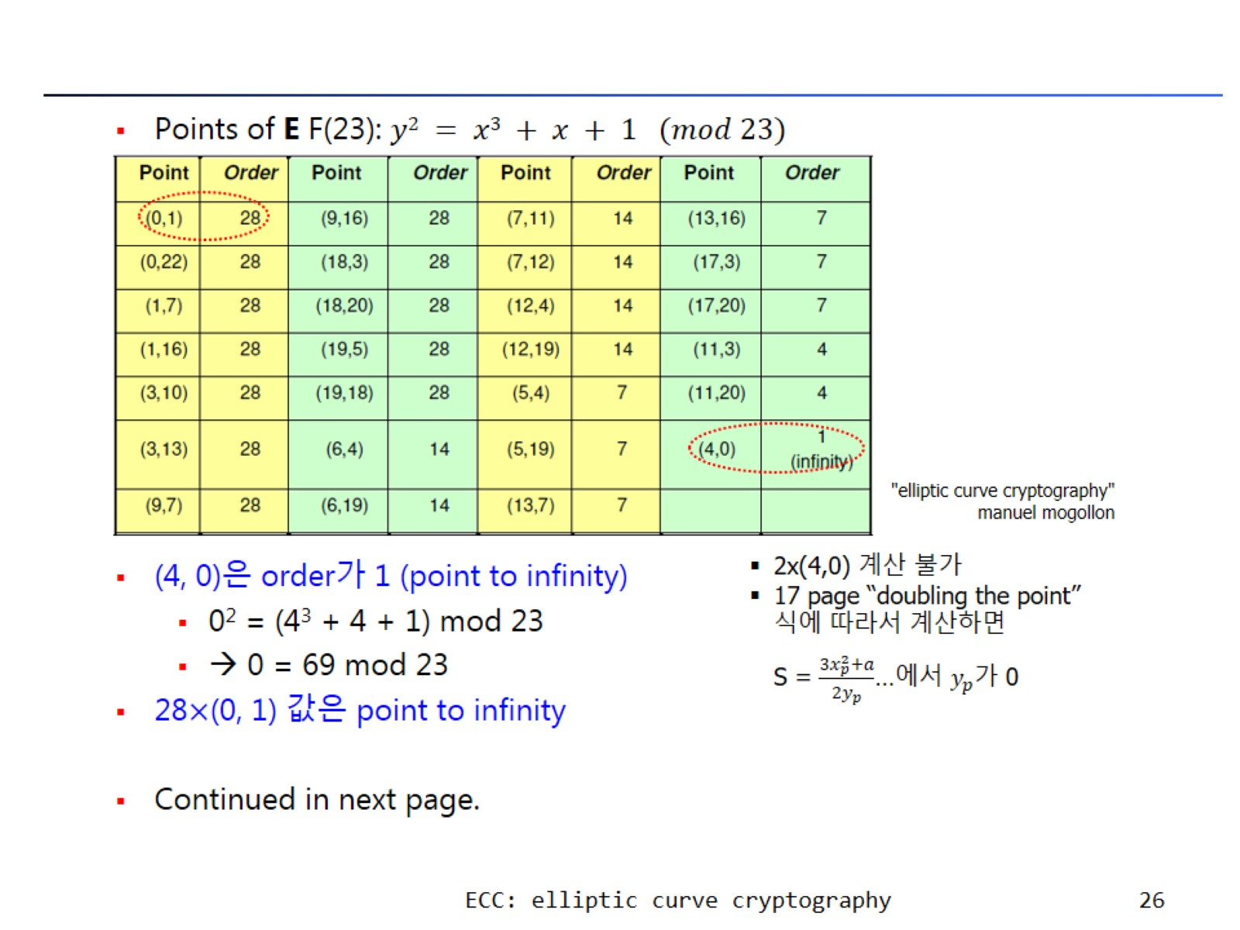

Slide 27
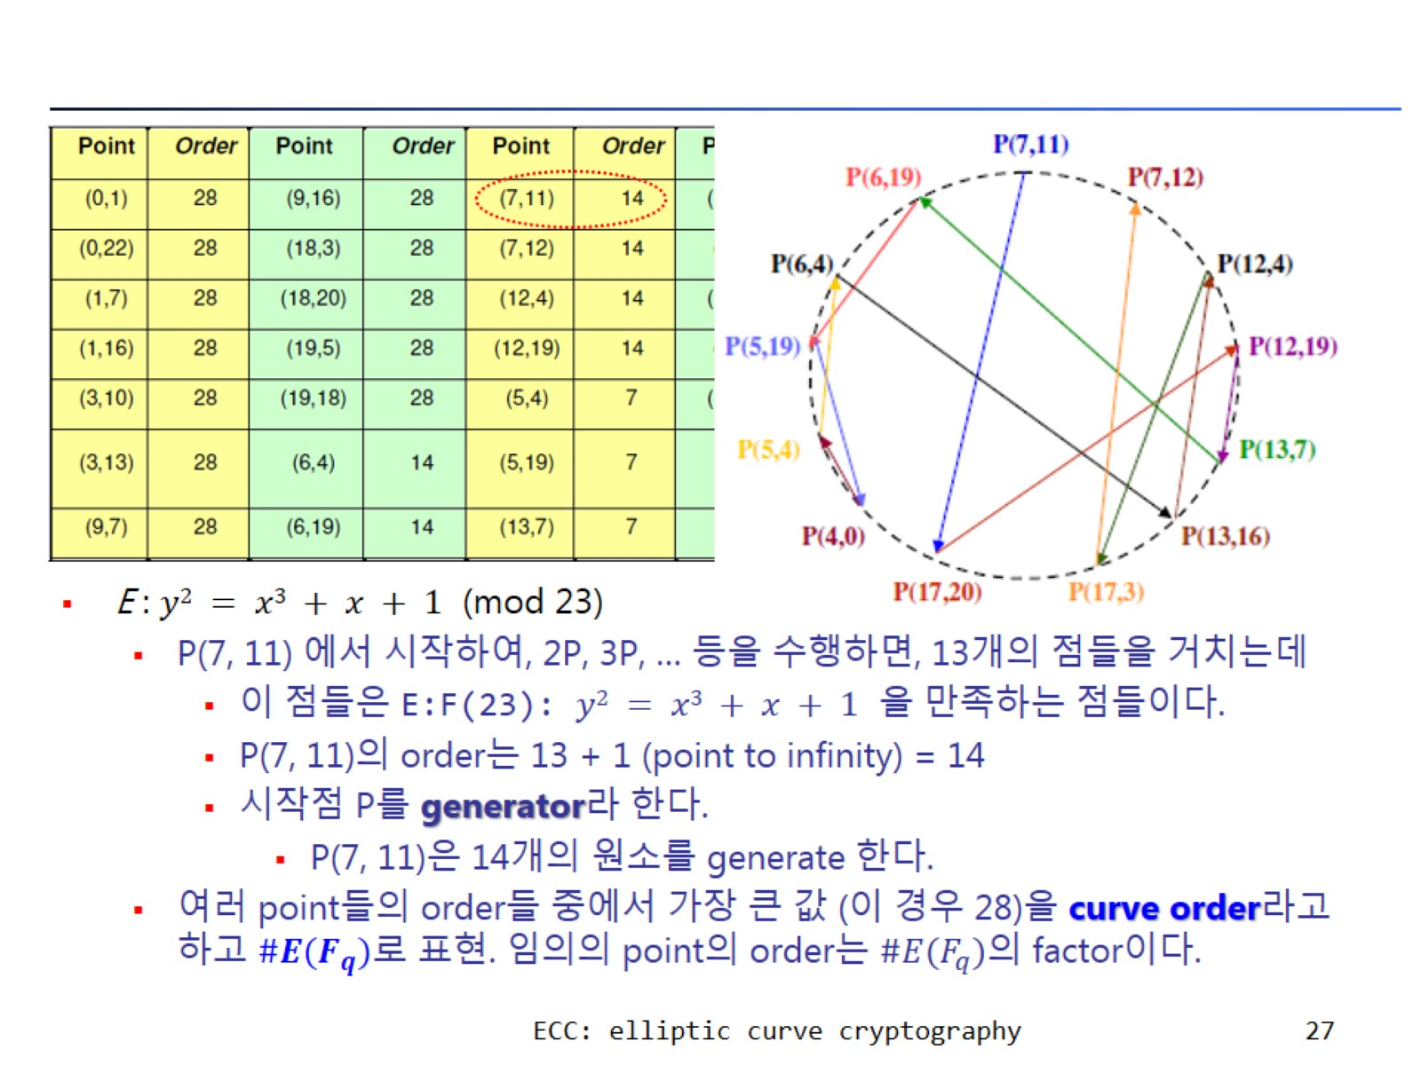

Slide 28
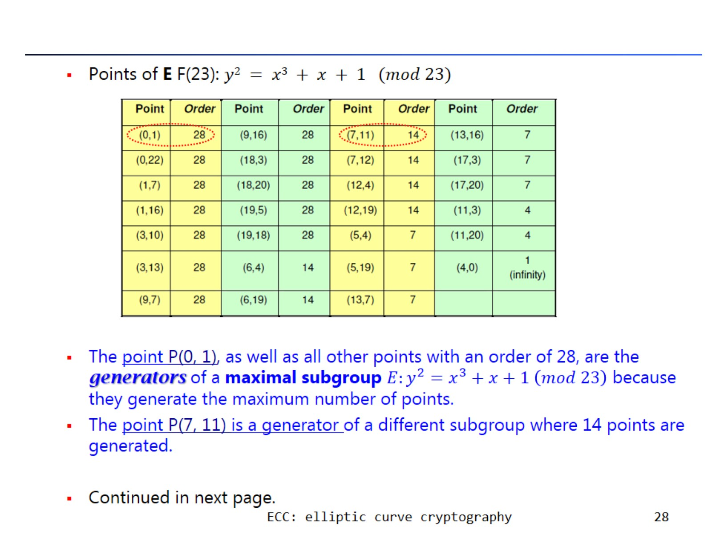

Slide 29
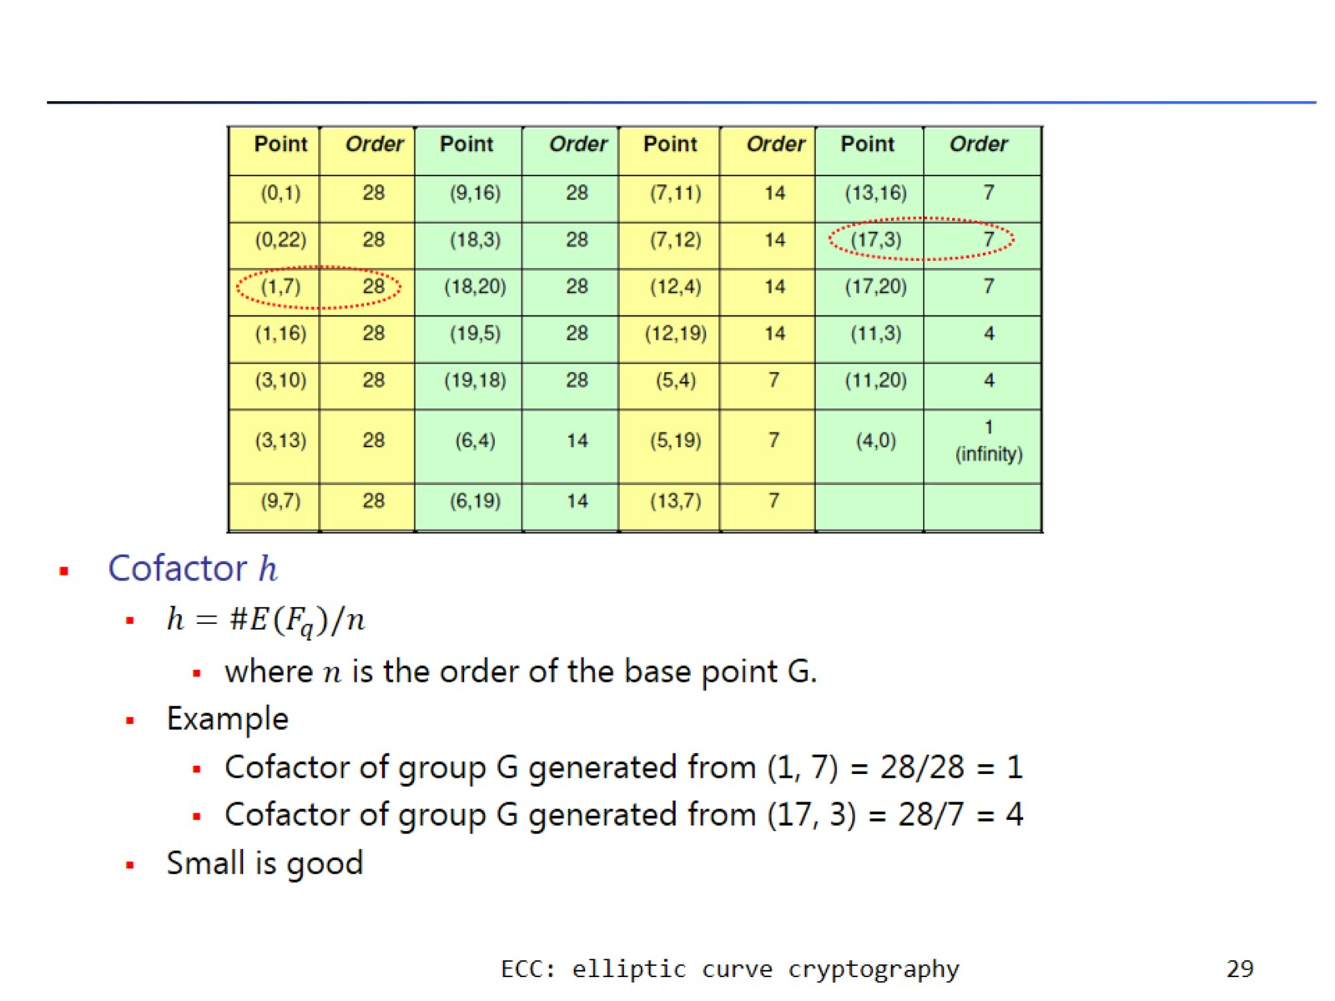

Slide 30
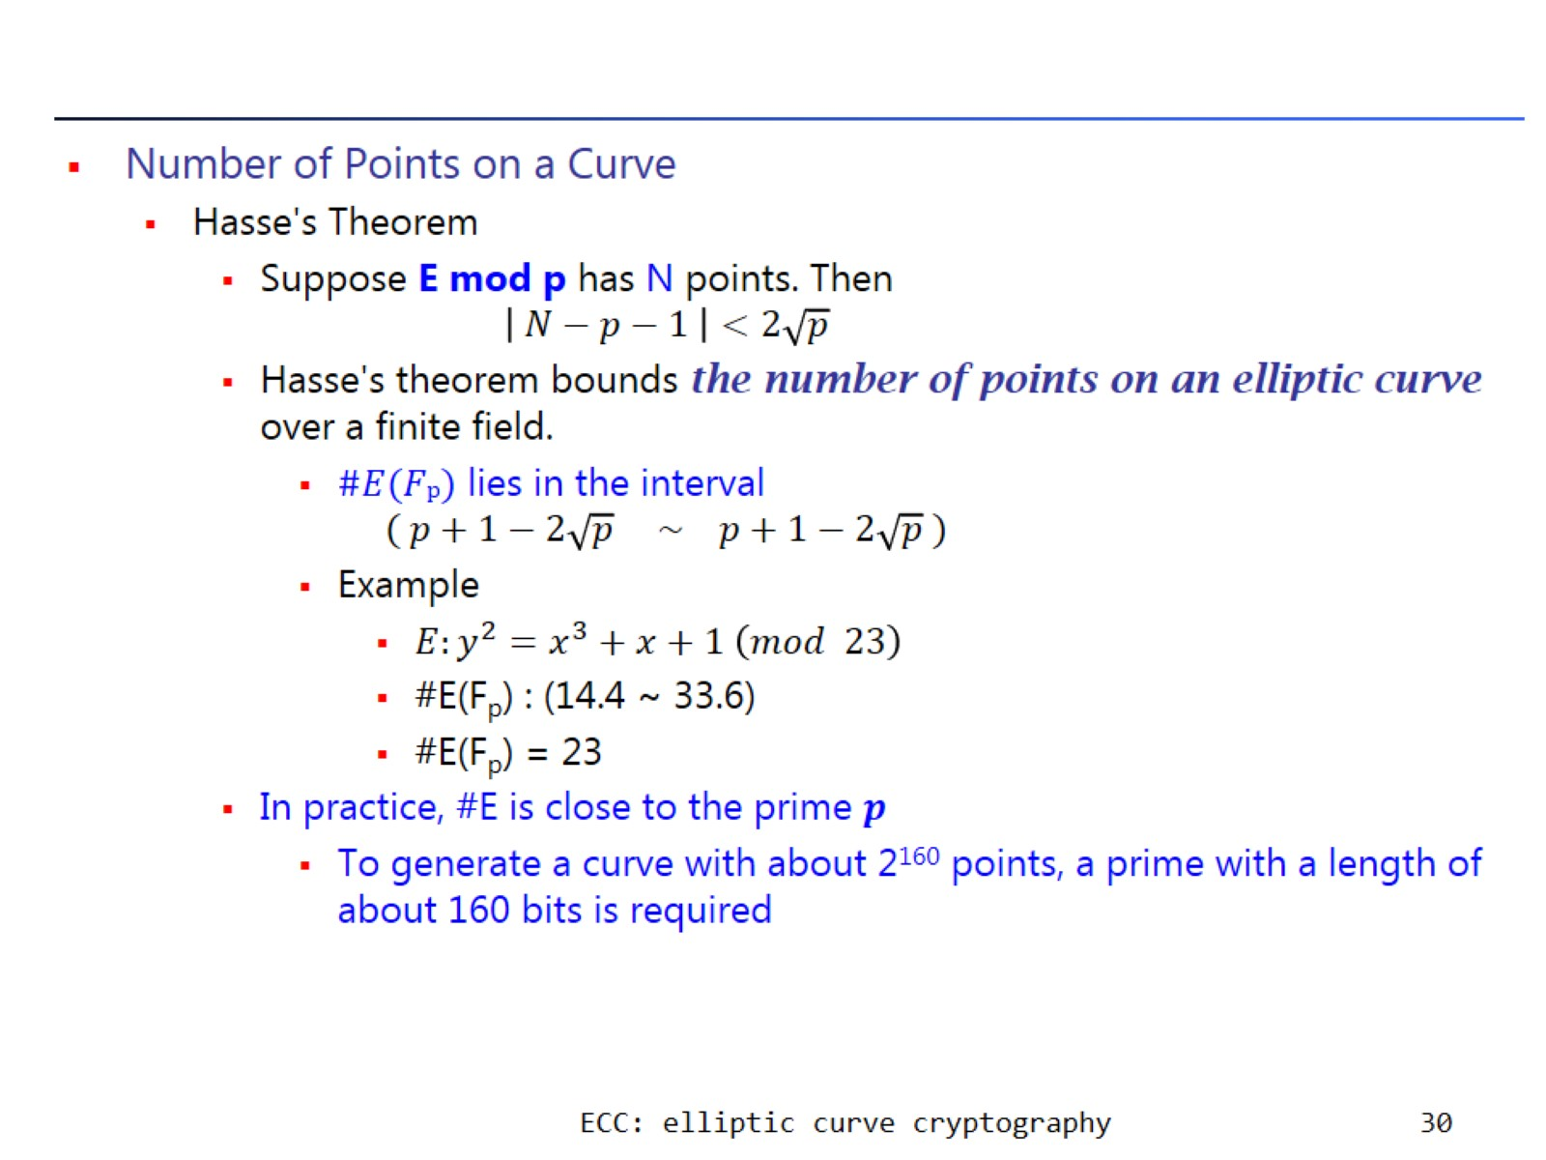

Slide 31
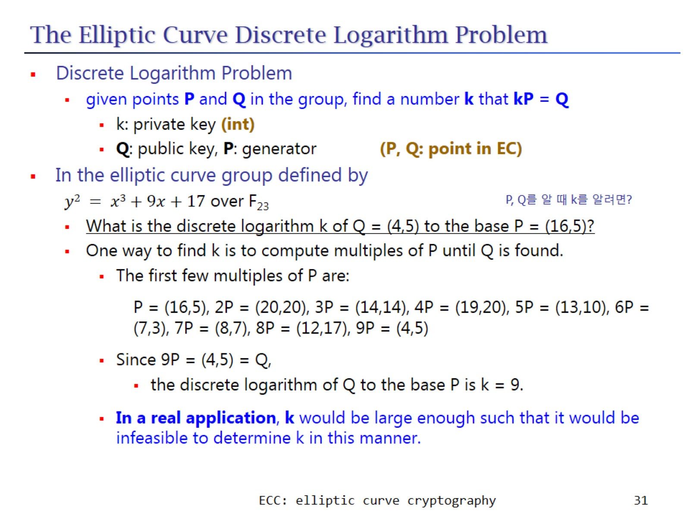
The Elliptic Curve Discrete Logarithm Problem

Slide 32
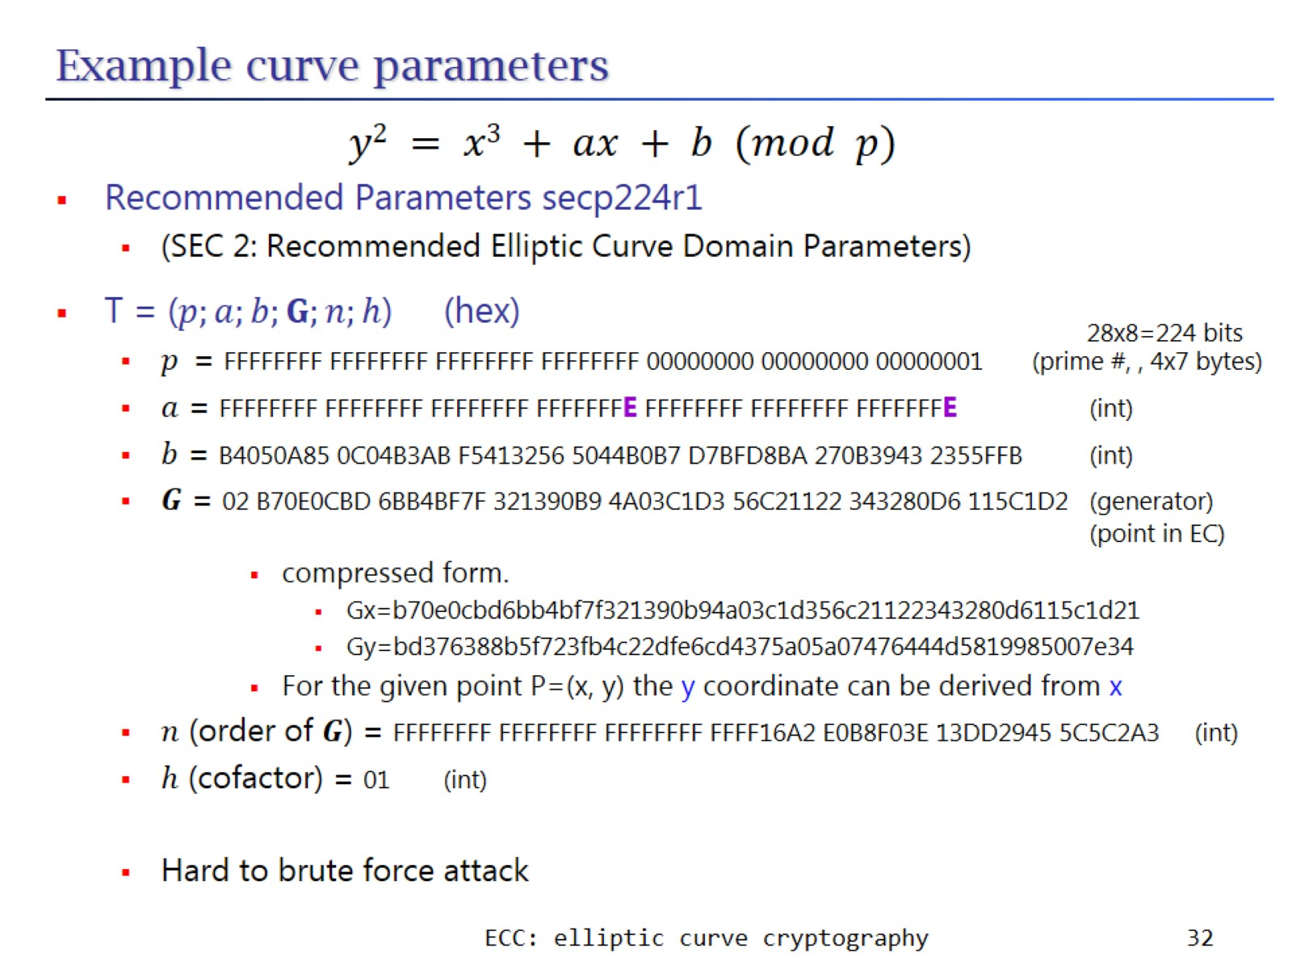
Example curve parameters

Slide 33
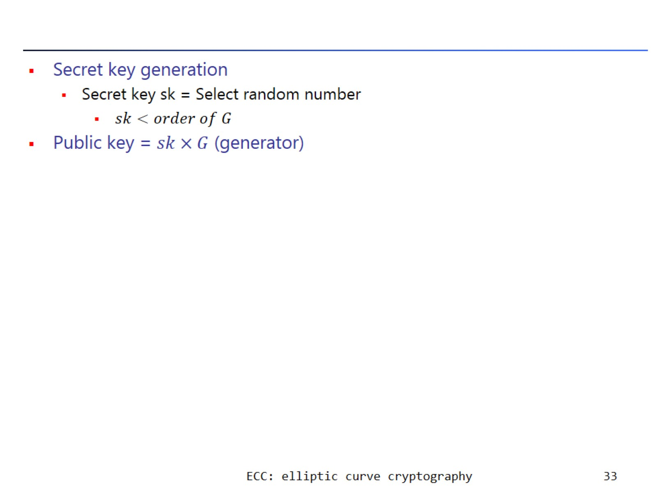

Slide 34
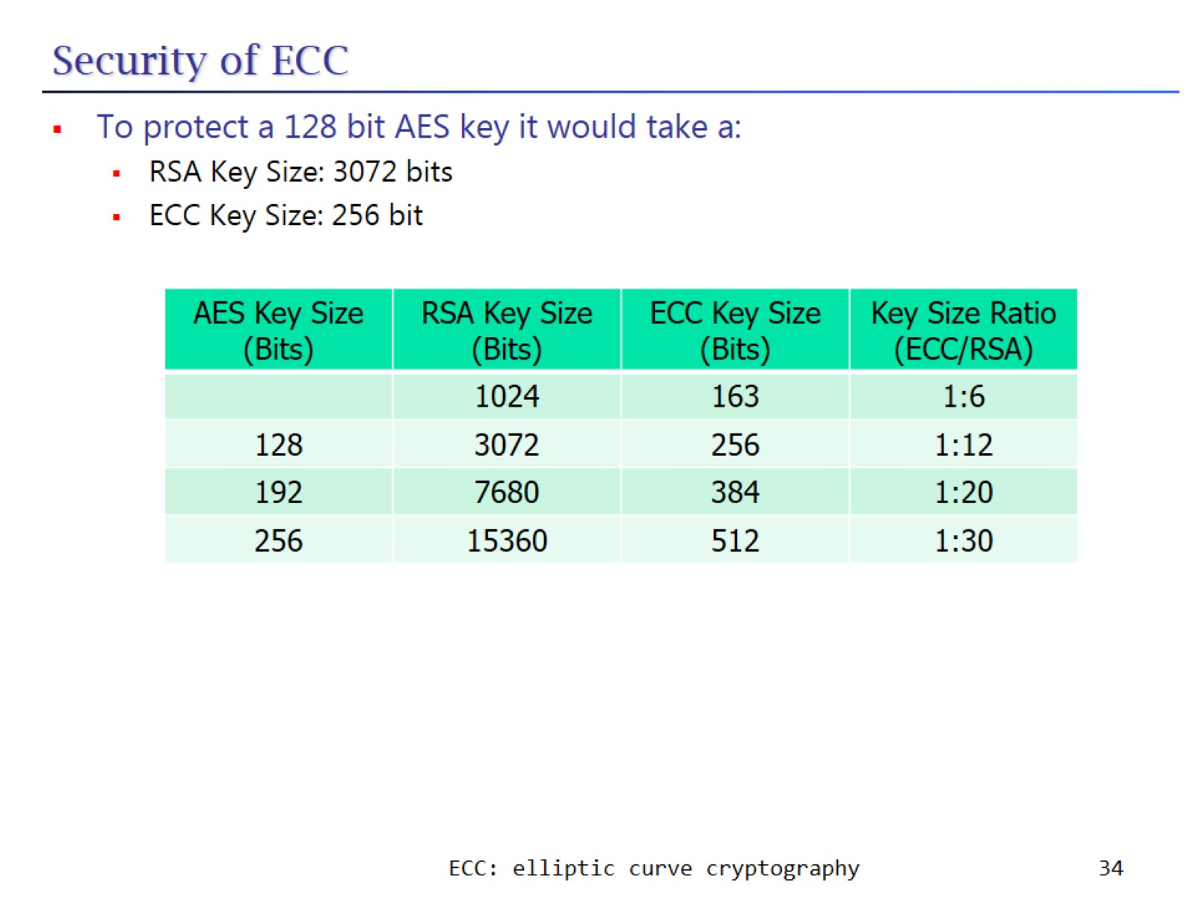
Security of ECC

Slide 35
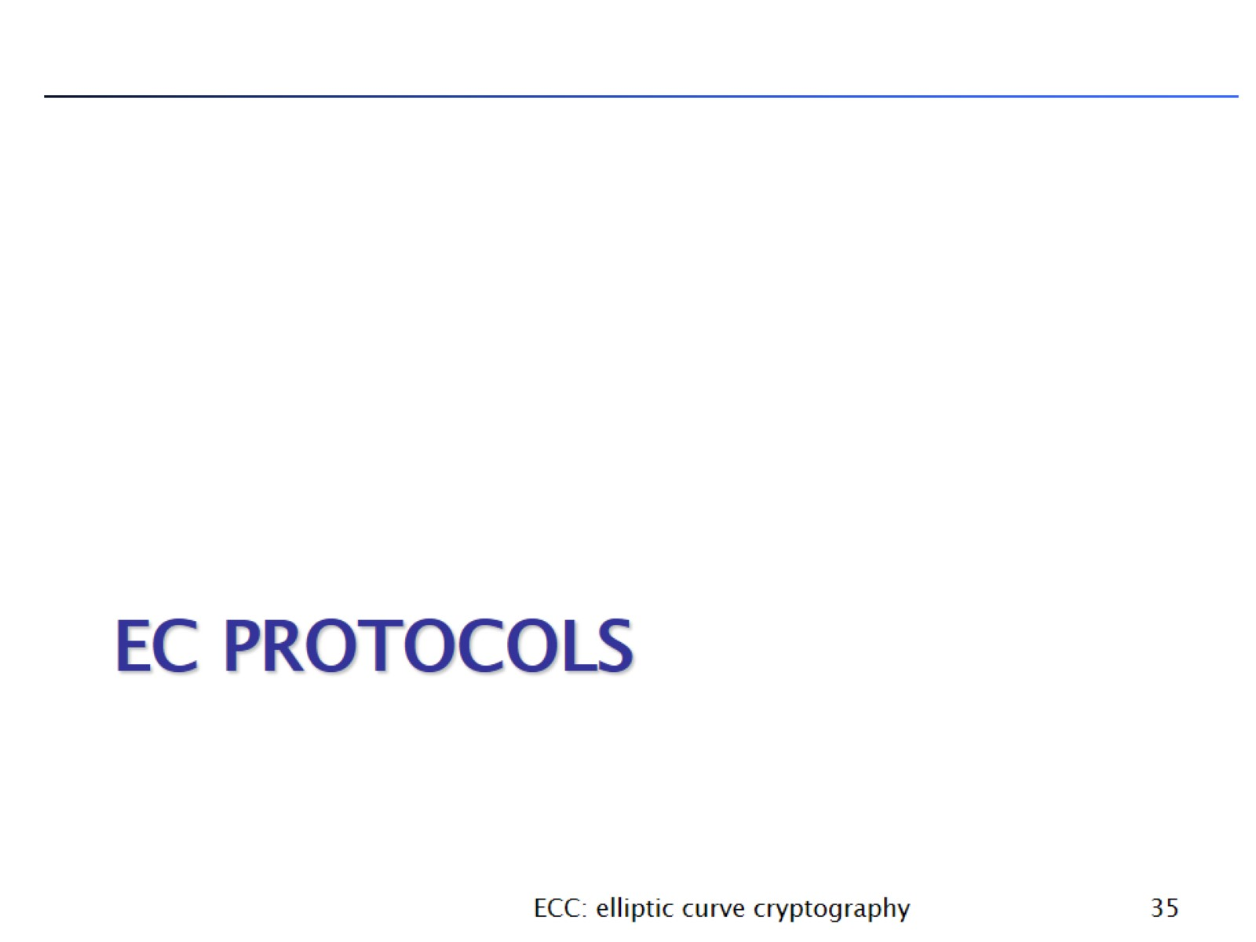
EC protocols

Slide 36
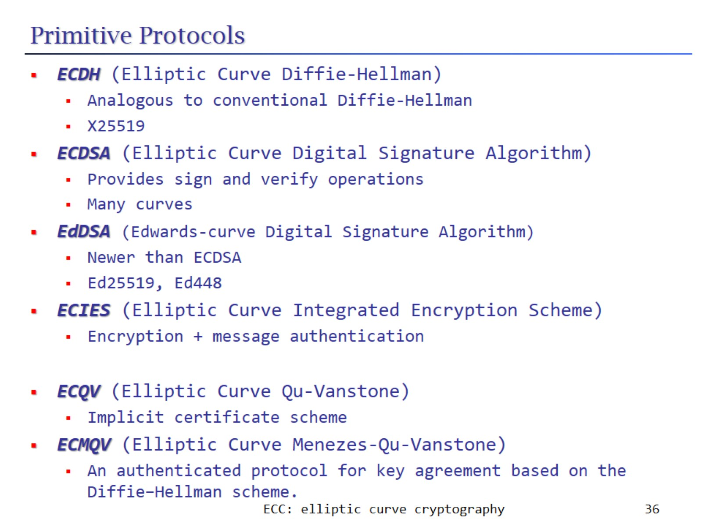
Primitive Protocols

Slide 37
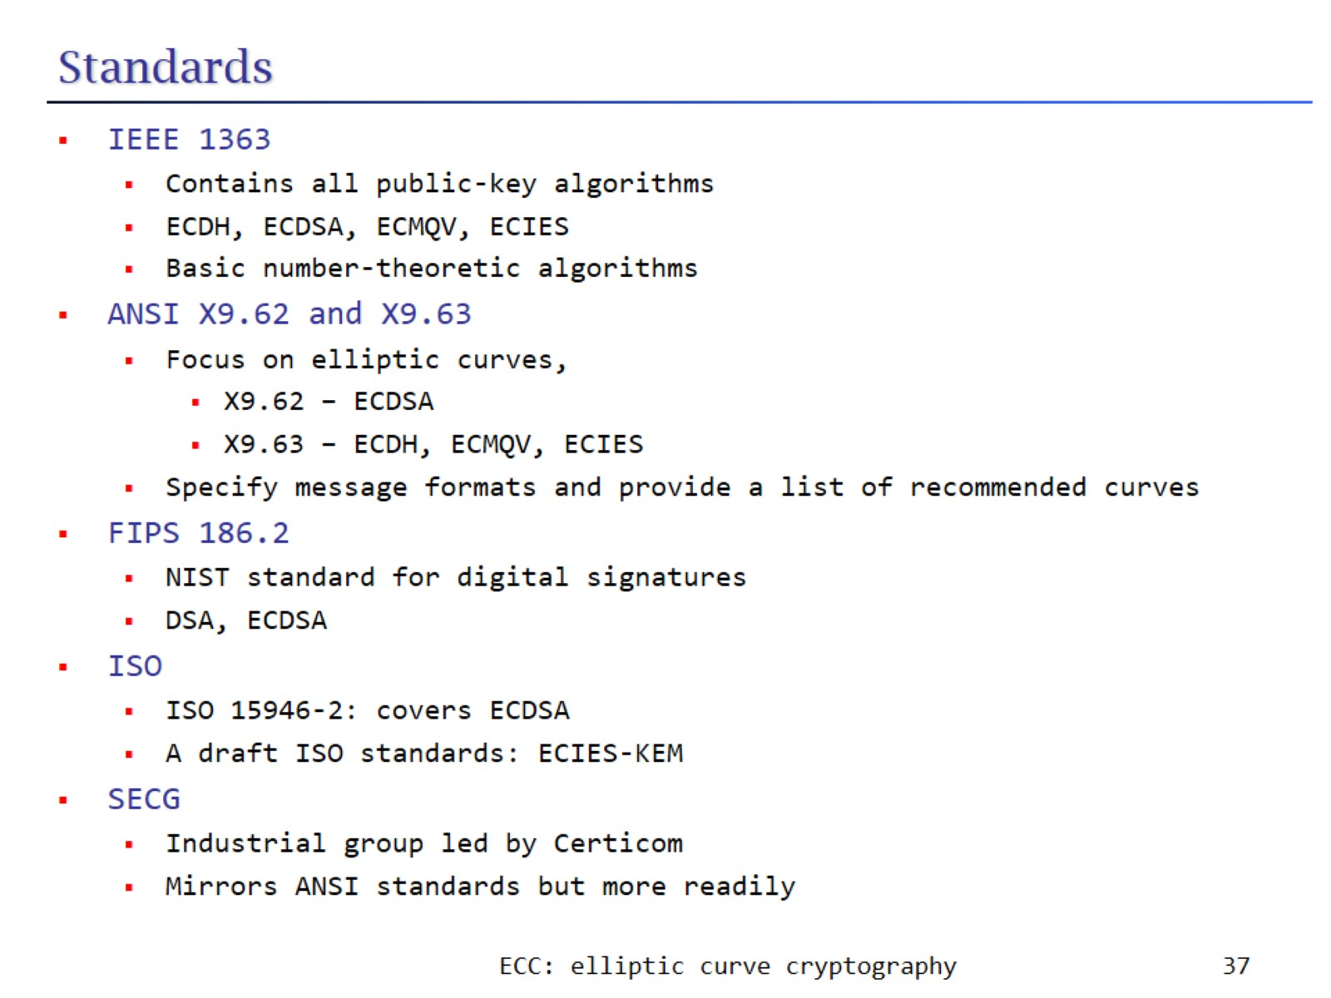
Standards

Slide 38
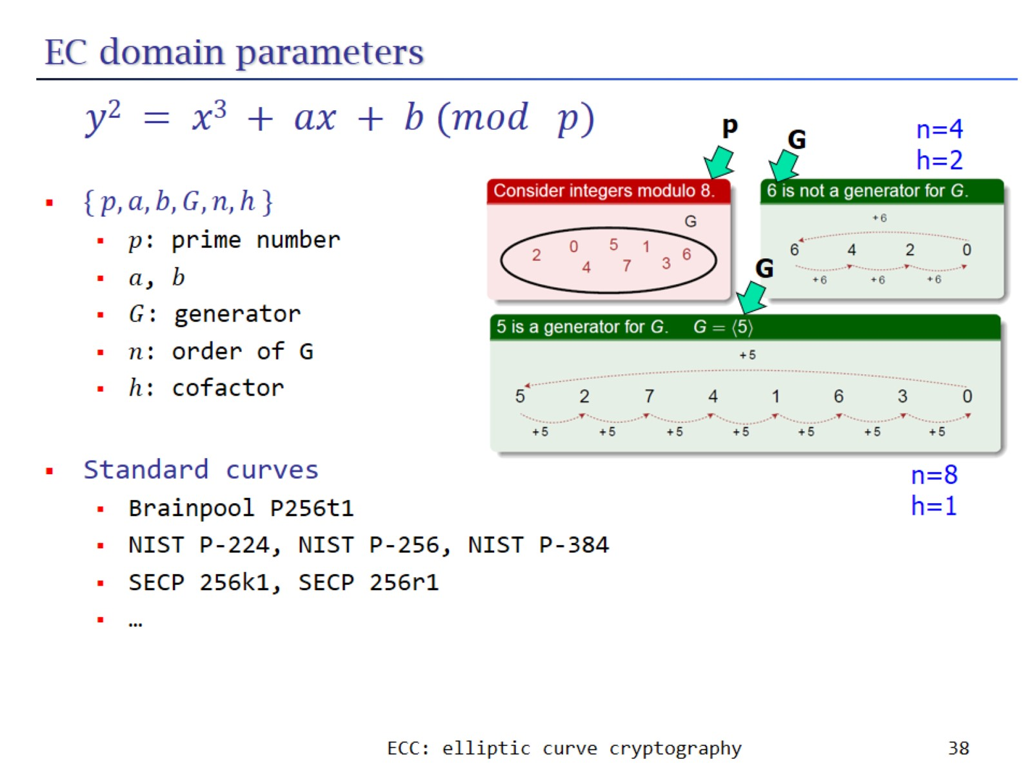
EC domain parameters

Slide 39
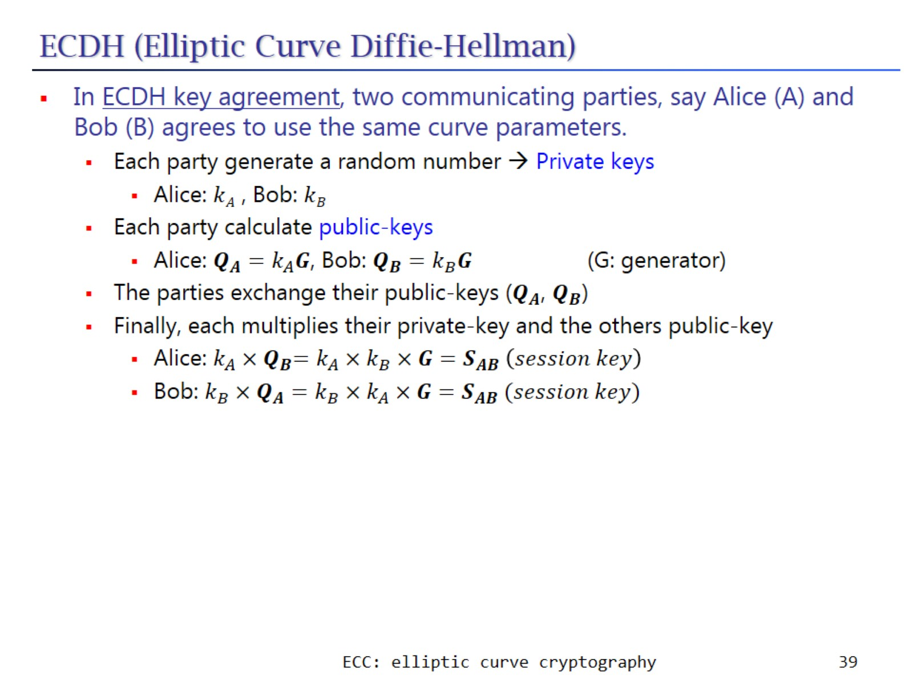
ECDH (Elliptic Curve Diffie-Hellman)

Slide 40
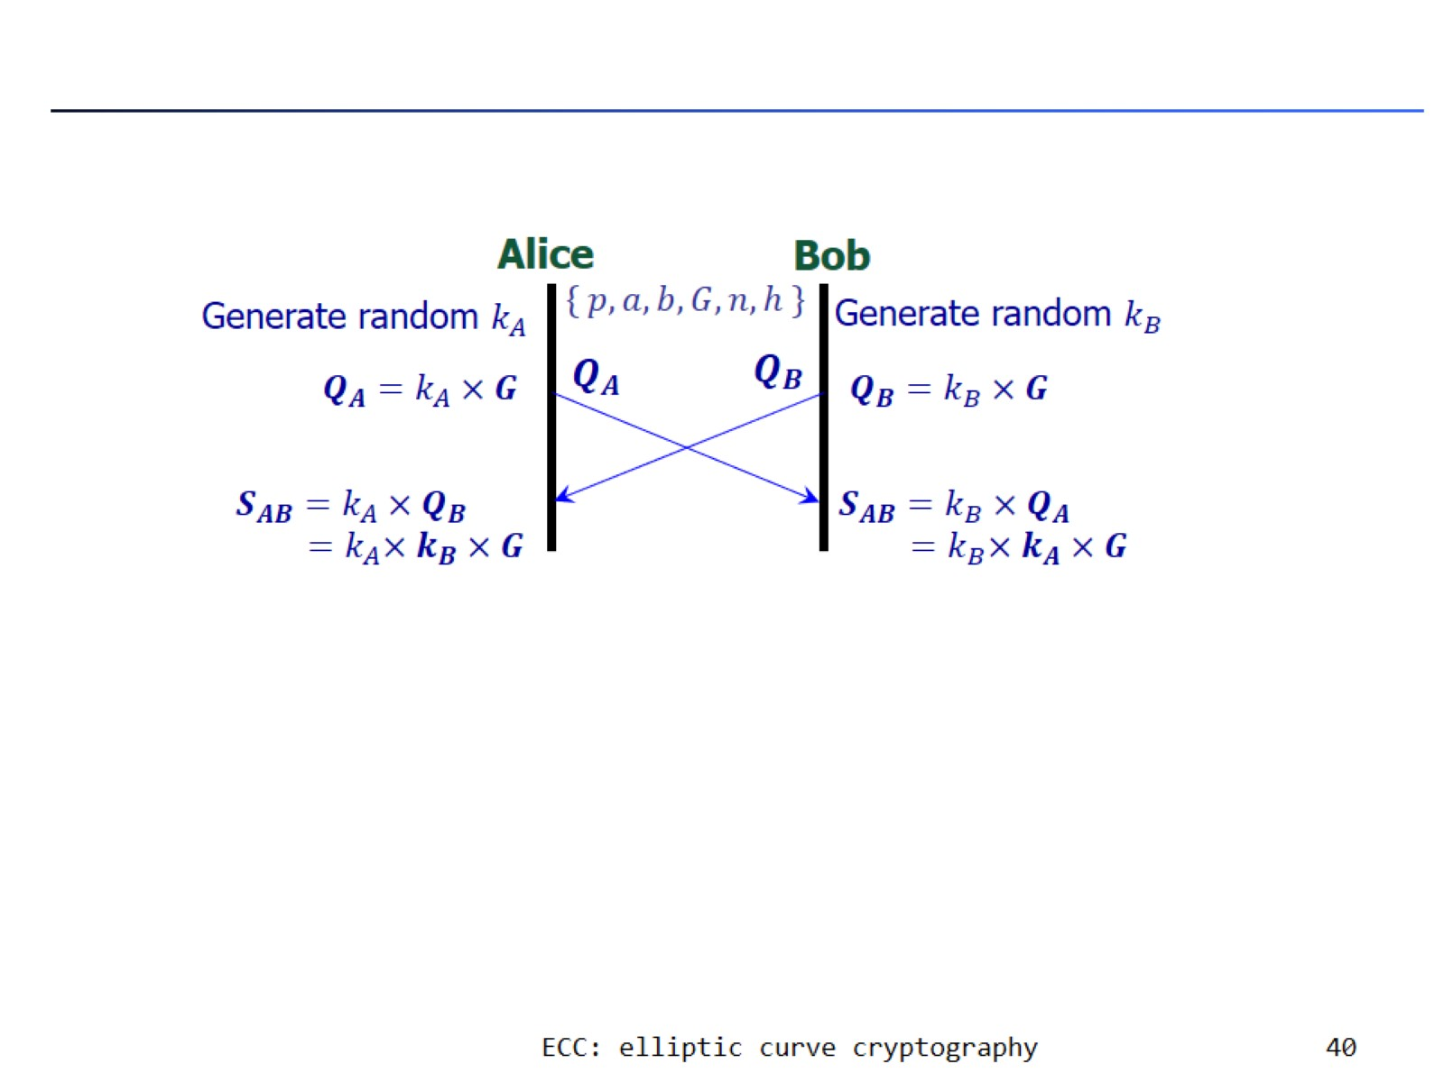

Slide 41
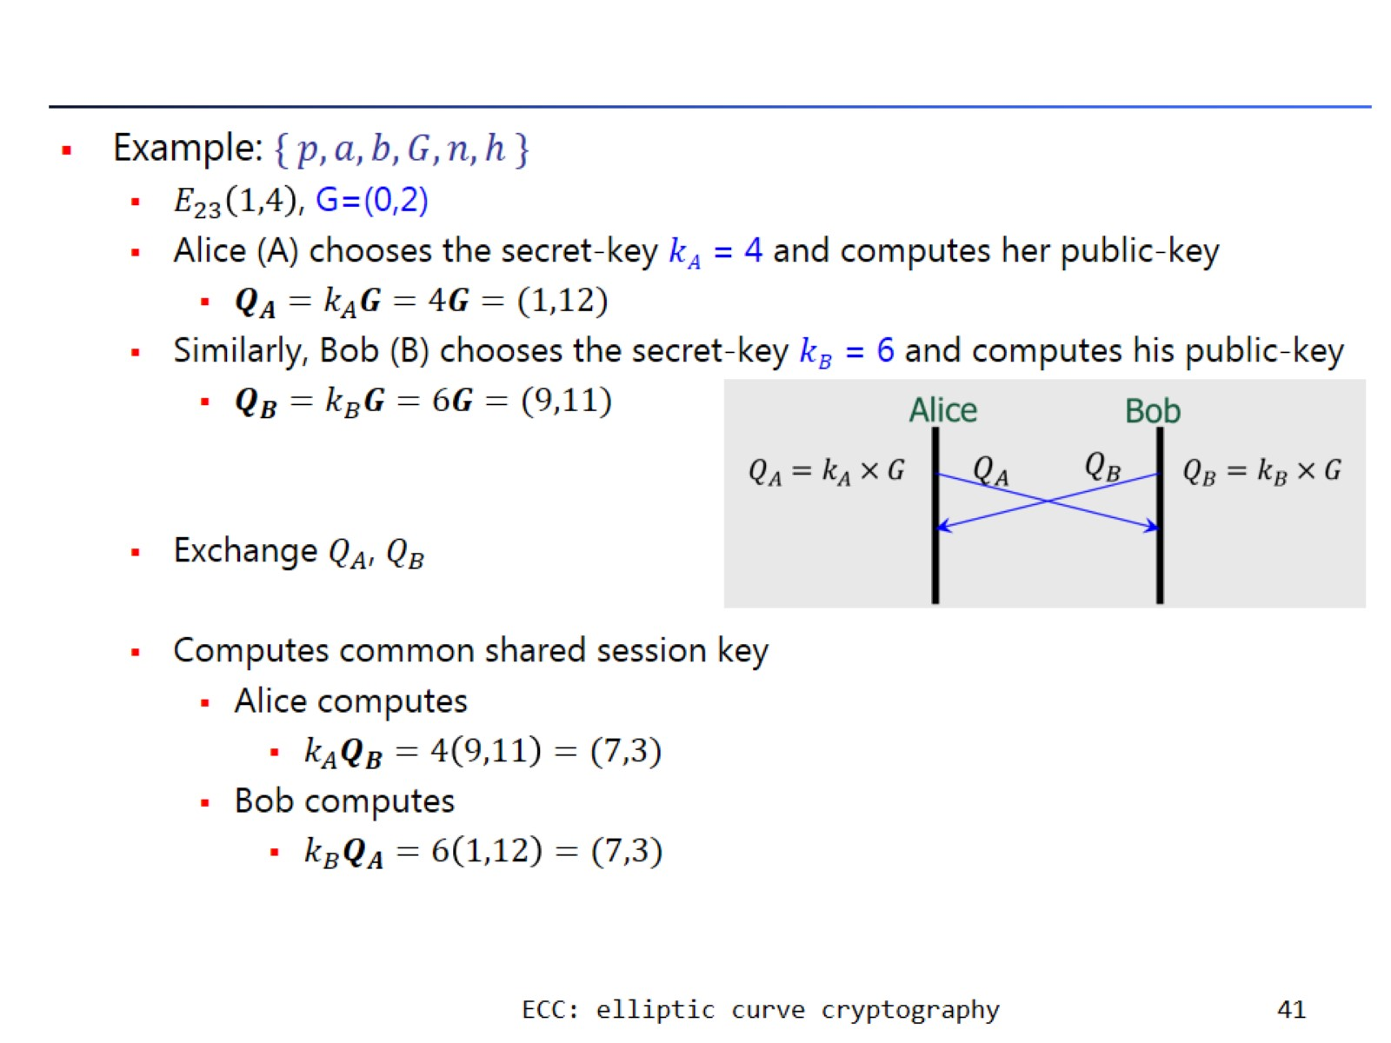

Slide 42
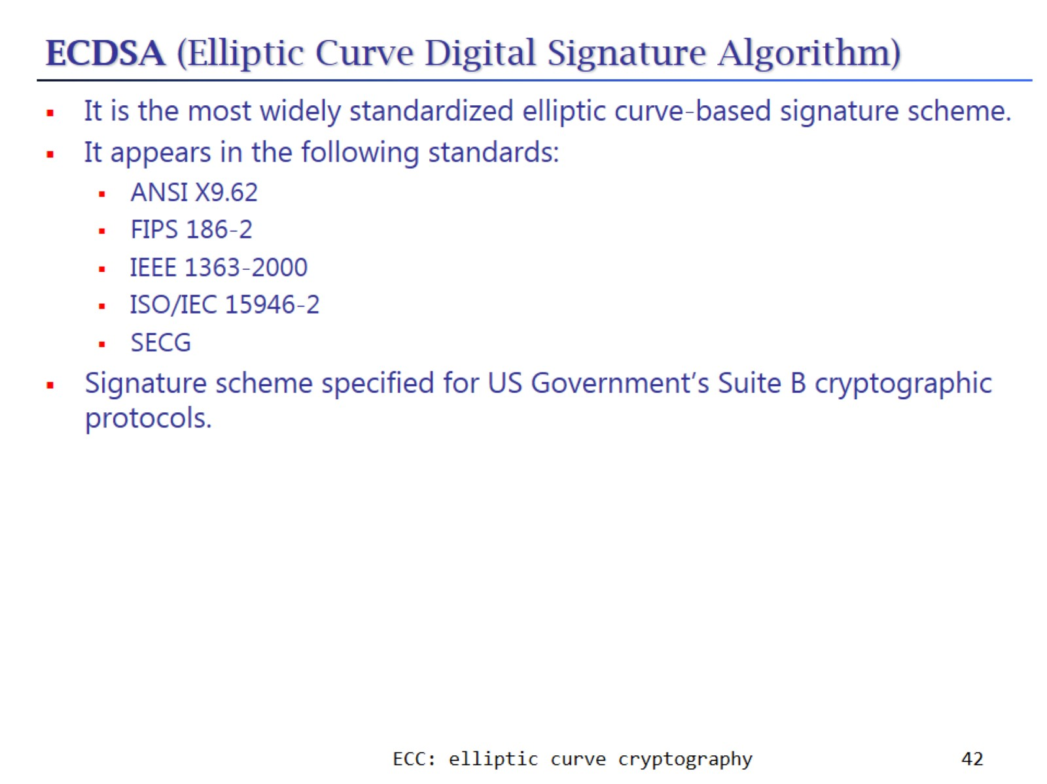
ECDSA (Elliptic Curve Digital Signature Algorithm)

Slide 43
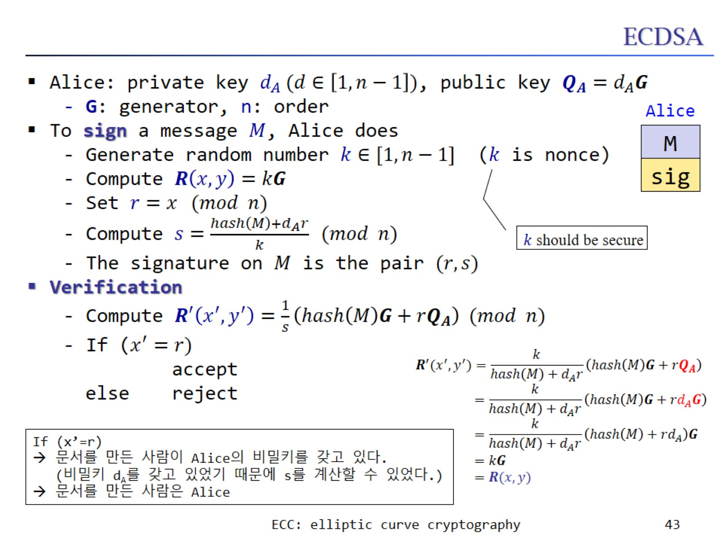
ECDSA

Slide 44
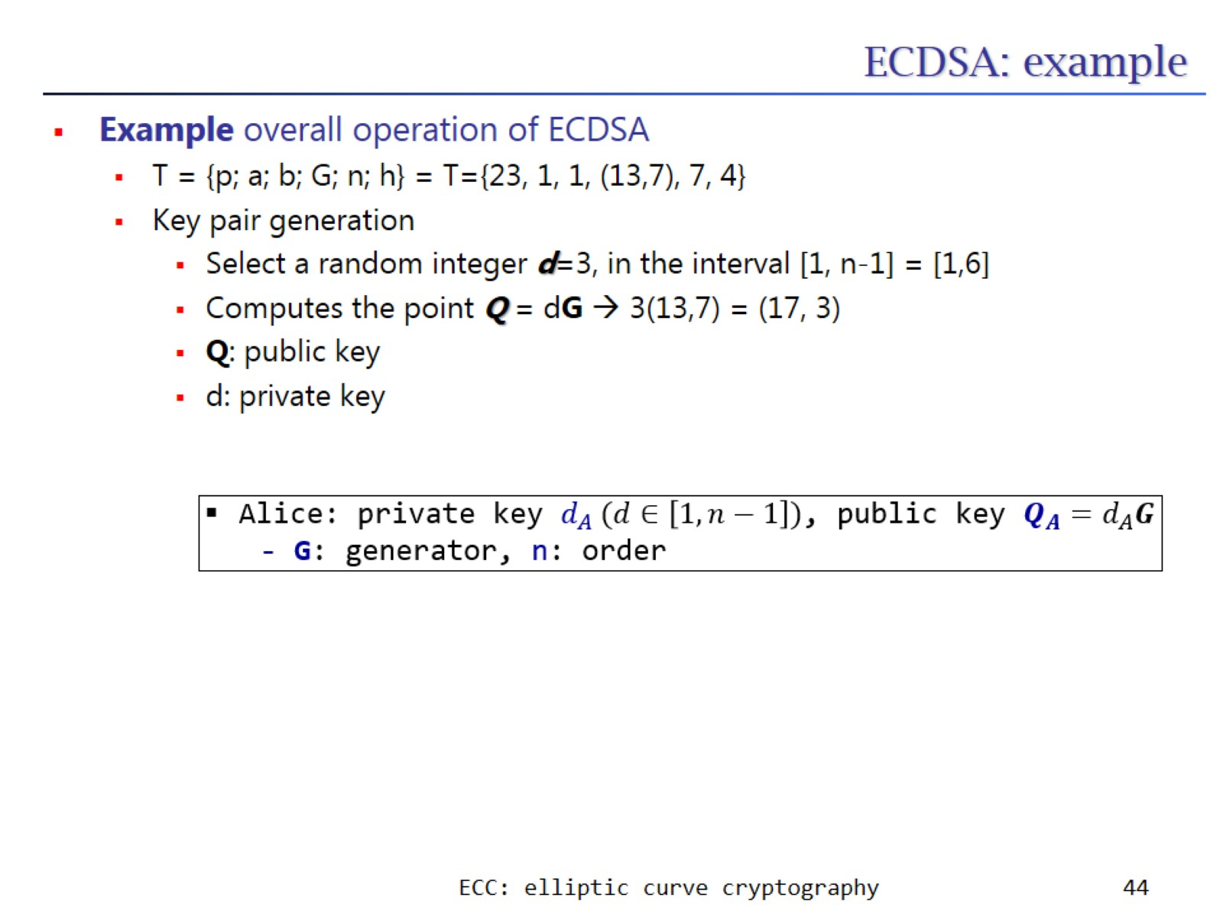
ECDSA: example

Slide 45
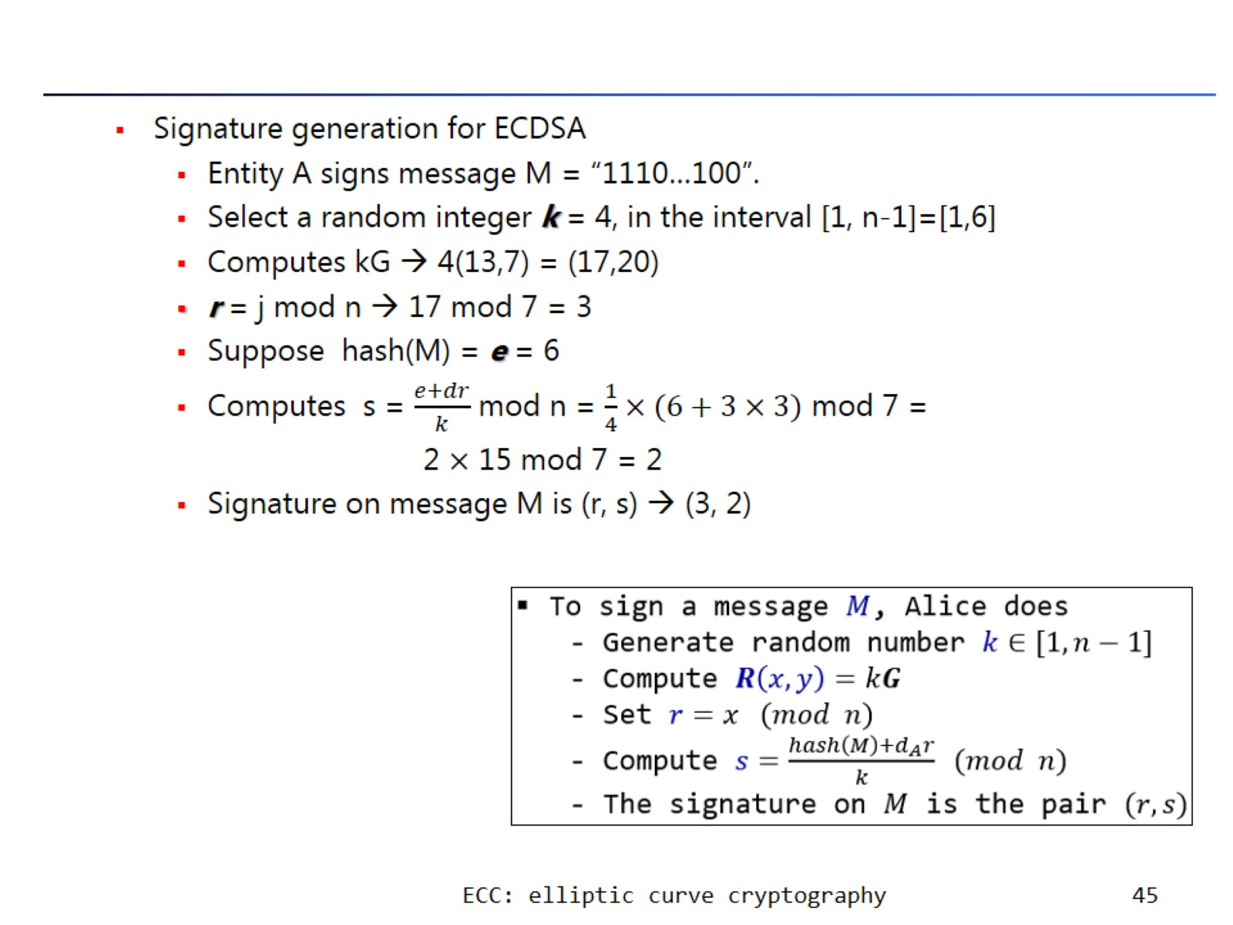

Slide 46
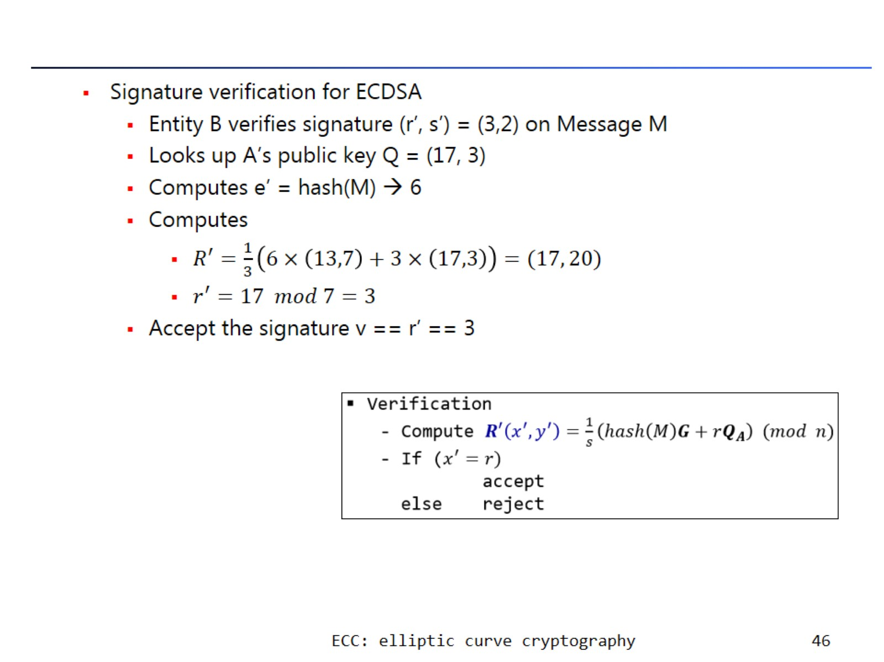

Slide 47
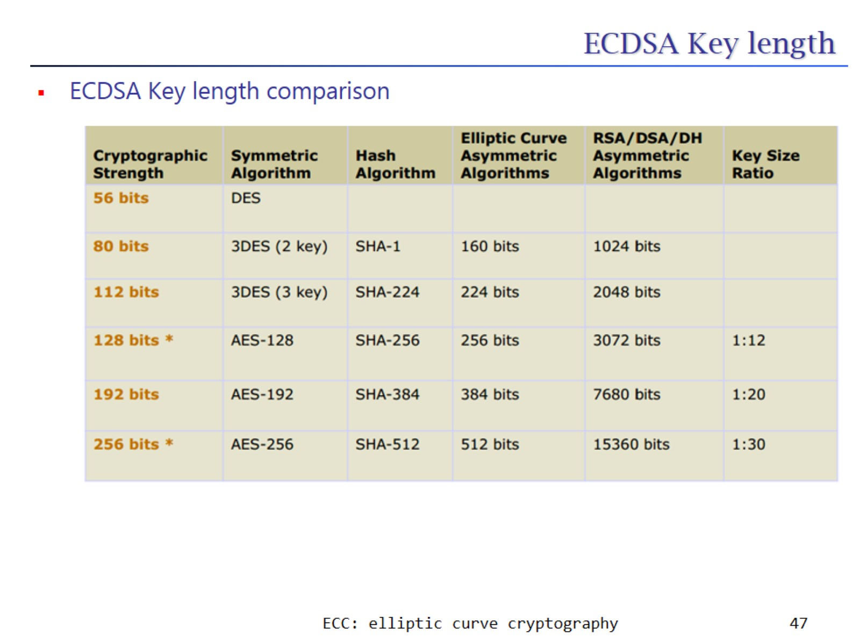
ECDSA Key length

Slide 48
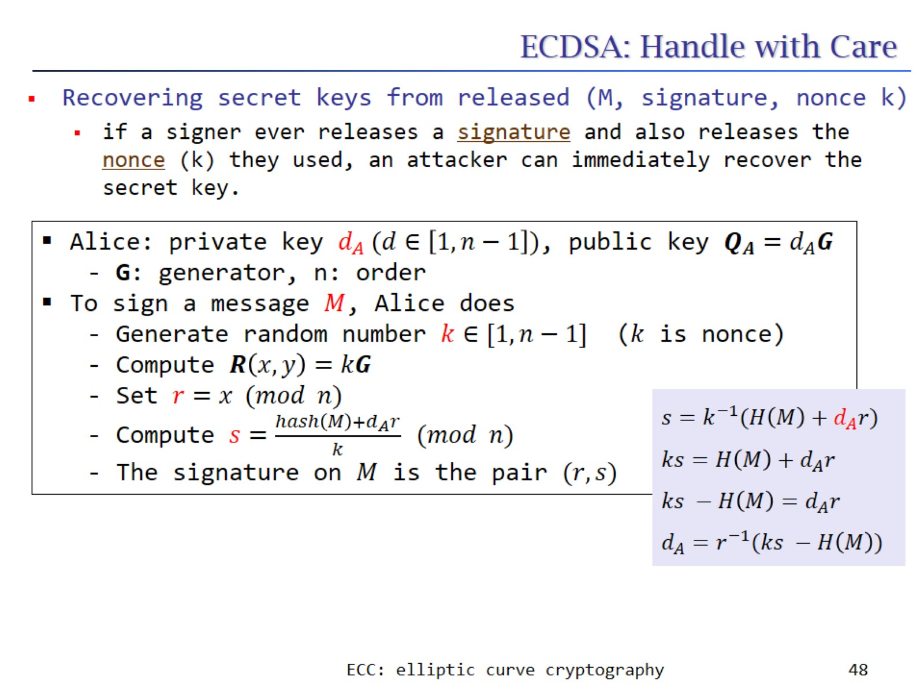
ECDSA: Handle with Care

Slide 49
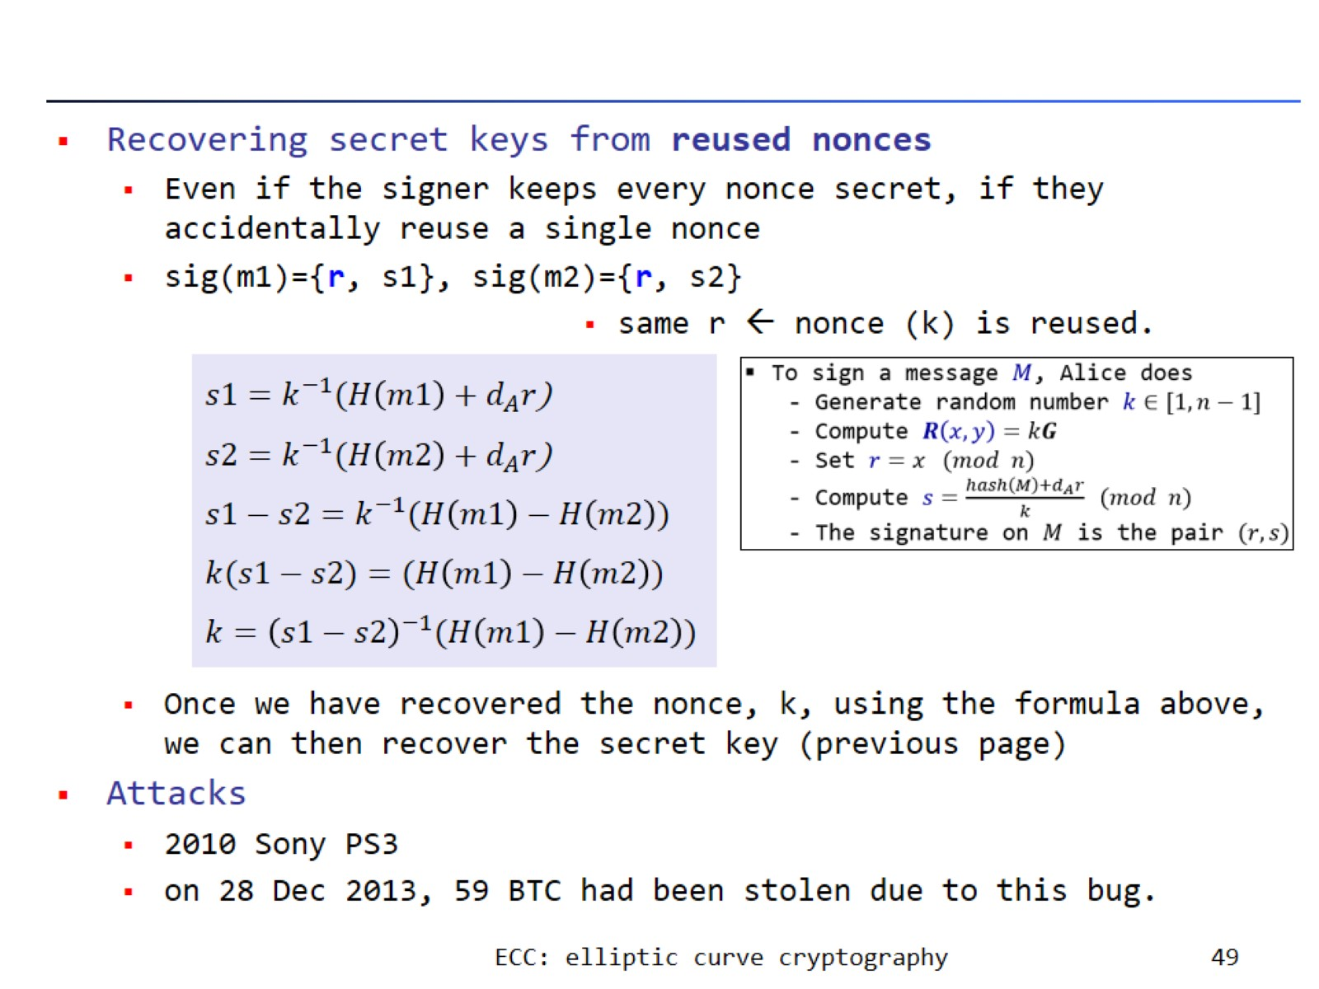

Slide 50


Slide 51

EdDSA (Edwards-curve Digital Signature Algorithm)

Slide 52


Slide 53

EdDSA: Fault attack (for deterministic cryptography scheme)

Slide 54

ECIES (Elliptic Curve Integrated Encryption Scheme)

Slide 55


Slide 56

Schnorr Signature

Slide 57

property of linearity

Slide 58


Slide 59

advantages

Slide 60

In bitcoin

